Slide 1
Principles and Applications of Symmetry in Magnetism Summer School
Lecture 3
Jakub Železný

Slide 2
Symmetry of response (and other) tensor
Transformations of tensors
Time-reversal symmetry
Tensor symmetrization
Beyond point groups
Symmetry of local effects
Equivalent magnetic configurations
Expansions in magnetization
Symmetry of magnetic interactions
Non-relativistic symmetry analysis
How it works?
Determining the non-relativistic symmetry operations
What it’s used for?
Symmetr – a code for symmetry analysis

Slide 3
Repository: https://bitbucket.org/zeleznyj/linear-response-symmetry
Some documentation available here
Can be cloned using
‘git clone git@bitbucket.org:zeleznyj/linear-response-symmetry.git’
Can be installed with pip: ‘pip install symmetry’
uses Findsym internally to find symmetry group => findsym is linux only, so most features only work on linux
On other OSs can be run through docker
Can be run from terminal or used as python library

Slide 4
Uses findsym input format: described in symmetr/findsym/findsym.txt
MnTe
0.01
1
1.0 0.0 0.0
-0.5 0.866025403784439 0.0
0.0 0.0 2.0
2
P
4
Mn Mn Te Te
magnetic
0 0 0 1 3 0
0 0 0.5 -1 -3 0
0.333333 0.666667 0.75 0 0 0
0.666667 0.333333 0.25 0 0 0
Name (unimportant)
Numerical precision
Bravais lattice vectors
Magnetic moments given in the basis of normalized Bravais lattice vectors
Centering
Number of atoms
Atom types
Atomic positions and magnetic moments

Slide 5
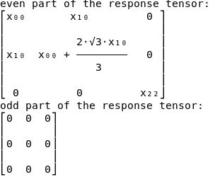
Example input files in folder ‘tests’
MnTe
symmetr res j E -f MnTe_inp1.in
Specifies response mode
Input file name
observable
perturbation
Results given in a cartesian coordinate system

Slide 6
MnTe
0.01
1
1.0 0.0 0.0
-0.5 0.866025403784439 0.0
0.0 0.0 2.0
2
P
4
Mn Mn Te Te
magnetic
0 0 0 1 3 0
0 0 0.5 -1 -3 0
0.333333 0.666667 0.75 0 0 0
0.666667 0.333333 0.25 0 0 0
The cartesian coordinate system is the one in which the bravais lattice vectors are defined
b
y
c
a
z
x

Slide 7
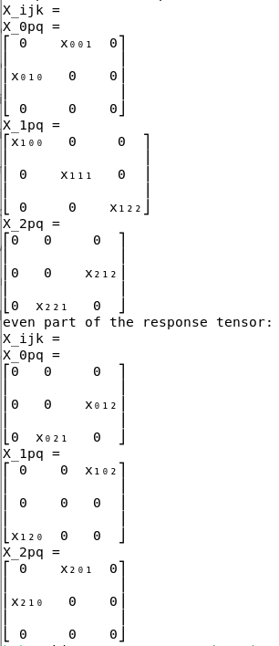
Spin current in NiF₂ (same symmetry as RuO₂)
symmetr res s.v E -f findsym.in
Spin current

Slide 8
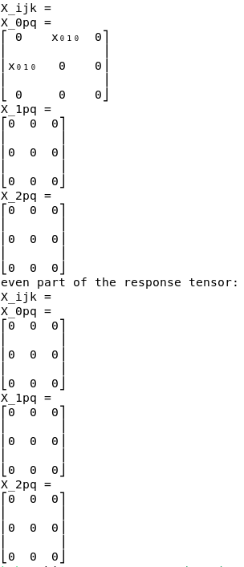
Spin current in NiF₂ without spin-orbit coupling
symmetr res s.v E -f findsym.in --noso
Symmetry without spin-orbit coupling

Slide 9
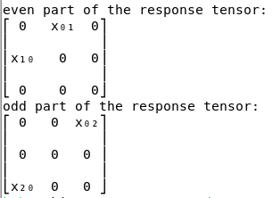
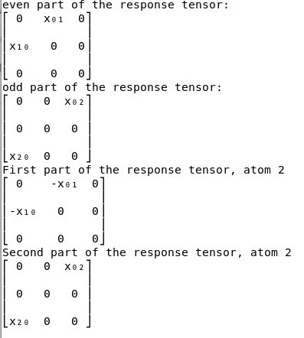
Edelstein effect in Mn2Au
symmetr res s E -f findsym.in –p 1
Projection on atom 1
symmetr res s E -f findsym.in –p 1 –p2 2
Projection on atom 1 and 2

Slide 10
Edelstein effect expansion in Mn2Au
symmetr res s E -f findsym.in –p 1 --exp 0
Expansion in L
symmetr res s E -f findsym.in –p 1 --exp 1
Expansion in L

Slide 11
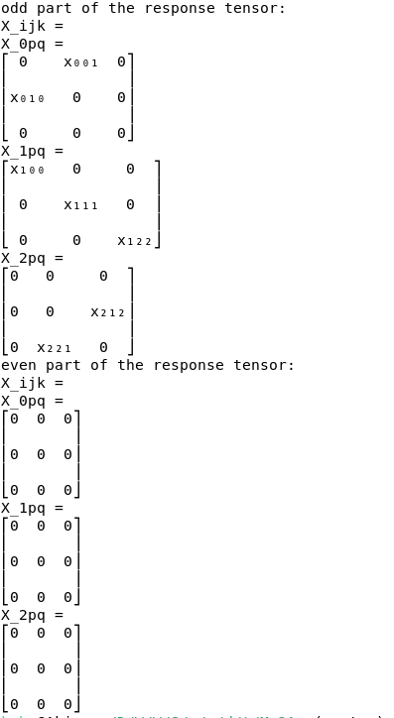
Higher order response in Mn2Au
symmetr res j E.E -f findsym.in

Slide 12
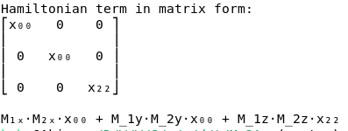
Magnetic interactions in Mn2Au
symmetr mham --sites 1,2 –f findsym.in
Magnetic interactions mode
sites

Slide 13
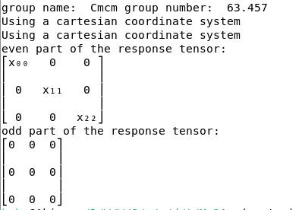
Also possible to specify group instead of structure
symmetr res j E –g “Cmcm”

Slide 14
Can also print out the symmetry operation => useful in the noso case
symmetr res j E -f findsym.in --noso --print-syms

