Slide 1
Principles and Applications of Symmetry in Magnetism Summer School
Lecture 3
Jakub Železný

Slide 2
Symmetry of response (and other) tensor
  Transformations of tensors
  Time-reversal symmetry
  Tensor symmetrization
Beyond point groups
  Symmetry of local effects
  Equivalent magnetic configurations
  Expansions in magnetization
  Symmetry of magnetic interactions
Non-relativistic symmetry analysis
  How it works?
  Determining the non-relativistic symmetry operations
  What it’s used for?
Symmetr – a code for symmetry analysis

Slide 3
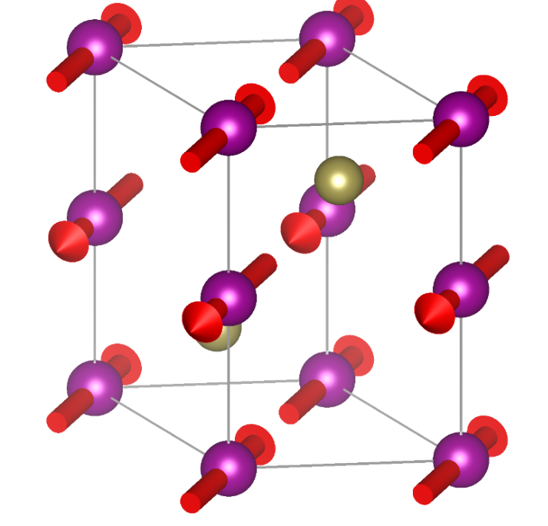
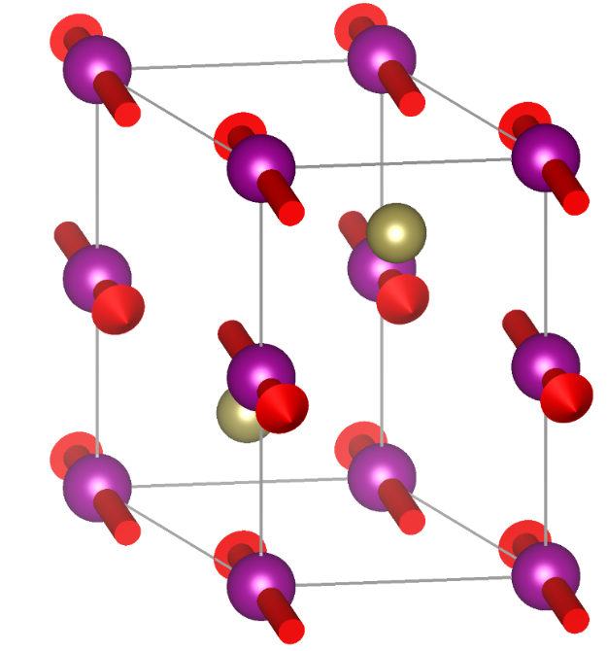
Symmetry depends on the orientation of magnetic moments with respect to the crystal
CmCm magnetic space group
P2₁/m
This dependence is a relativistic effect => due to spin-orbit coupling

Slide 4
Spin-orbit coupling
Non-relativistic quantum mechanics:
Pauli equation
Orbital and and spin degree of freedom are not coupled
Relativistic quantum mechanics:
Dirac equation
Orbital and spin degree of freedom are coupled

Slide 5
In the limit $c→∞$: Dirac equation $→$ Pauli equation
Lowest-order correction
Spin-orbit coupling:
In spherically symmetric potential:
Spin-orbit coupling is always present but is usually small
Largest in heavy elements
Even when it cannot be neglected, it can usually be treated as a perturbation

Slide 6
Spin-orbit coupling changes symmetry
Spin and spatial rotations are decoupled without spin-orbit coupling
Rotation in quantum mechanics
Spin angular momentum
Orbital angular momentum

Slide 7
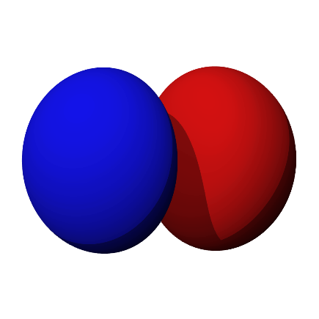
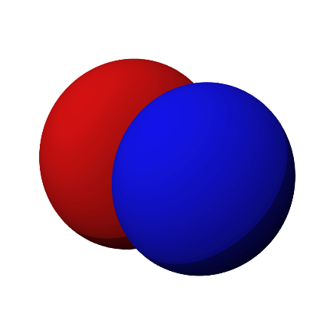

Spin rotations
360° rotation is -1!
Only a phase factor so does not matter for us
Rotation: $4z$
Spin x eigenstate
Spin y eigenstate
p_{x}
p_{y}

Slide 8

With spin-orbit coupling all rotations must contain both the spatial and the spin-part
Without spin-orbit coupling the two parts are decoupled
Spin (space, point) groups
W. F. Brinkman and R. J. Elliott, Proceedings of the Royal Society of London. Series A, Mathematical and Physical Sciences 294, 1438 (1966)
D. B. Litvin, W. Opechowski, Physica 76, 538-554 (1974)

Slide 9
Classification of spin point groups
D. B. Litvin, W. Opechowski, Physica 76, 538-554 (1974)
Pengfei Liu et al., Phys. Rev. X 12, 021016 (2022)
598 non-trivial (containing no pure spin rotations) spin-point groups
All spin point groups = pure spin rotation group $×$non-trivial point group

Slide 10
The spin-rotation symmetry can be illustrated with a simple tight-binding Hamiltonian
This also applies to the DFT Hamiltonian

Slide 11
Non-magnetic materials: an arbitrary spin rotation is a symmetry
Spin-space group = space group $×$ group of all spin-rotations
In magnetic materials, only some combinations of spin-rotations and spatial symmetry operations will be symmetries

Slide 12
30° spin rotation
Without spin-orbit coupling, these two states are connected by spin-rotation => they have the same symmetry
The two states are physically distinct

Slide 13
Collinear systems
Any spin-rotation along the collinear axis is a symmetry
Continuous symmetry => conserved quantity => component of spin along the collinear axis is conserved

Slide 14
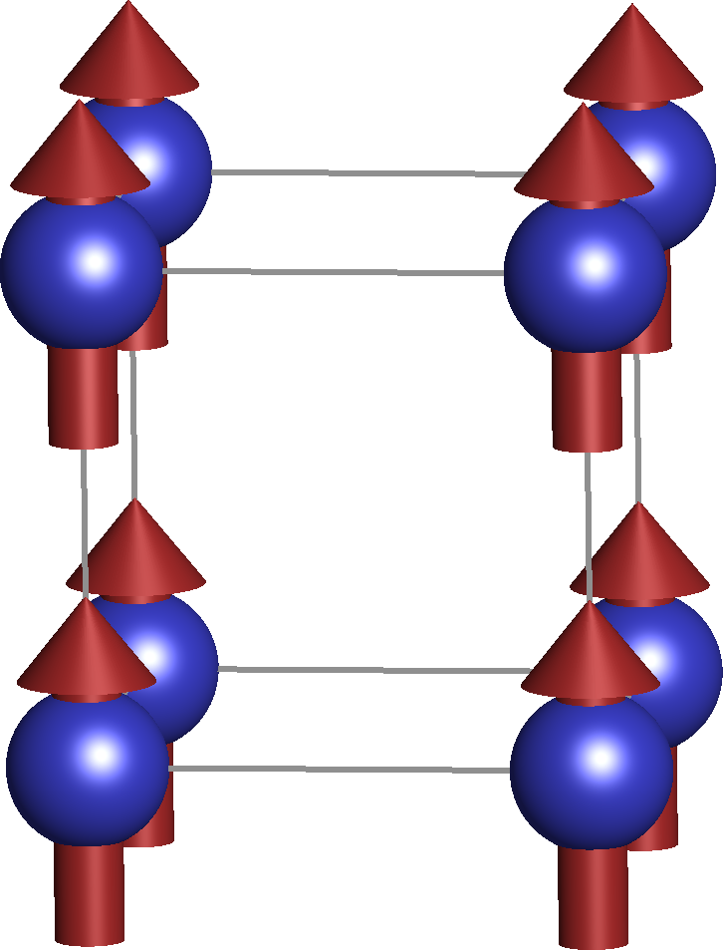
Arbitrary spin rotation
Non-magnetic case:
Ferromagnetic with spin-orbit coupling
Ferromagnetic without spin-orbit coupling

Slide 15
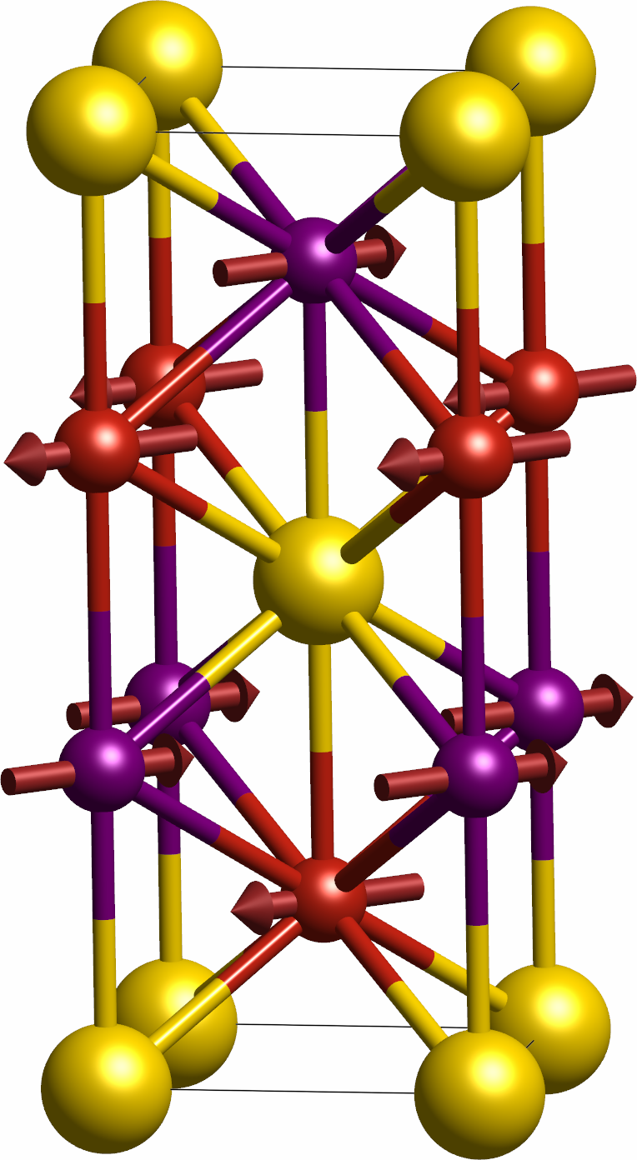

With more than one sublattice we have to keep track of site permutations
Inversion: Mn_{A} $→$ Mn_{B} => PT symmetry
Mn_{B}
Without spin-orbit coupling: Inversion + spin rotation
Mn_{A}
In collinear systems the only spin rotations can be either along the rotation axis or 180° around a perpendicular axis

Slide 16
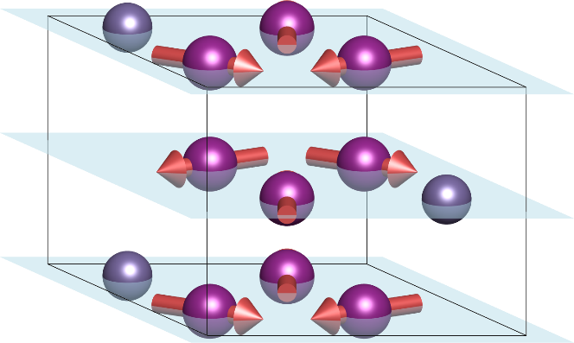
Non-collinear systems => no continuous spin-rotations
Physical phenomena are due to absence of symmetry => lower symmetry means more effects
Some spin-rotations in combination with the spatial symmetry operations will remain

Slide 17

Mirror = inversion + 2-fold rotation
Relativistic mirror:
A
Not a symmetry
A
B
C
C
B
Mirror
Without spin-orbit coupling:
$$A→A, B→C,C→B$$
A
Symmetry
C
B
The only aspect of the spatial symmetry operation that matters for the spin-rotation is the site permutation and time-reversal

Slide 18
How to find all non-relativistic symmetries?
Start with non-magnetic space group => all magnetic symmetries must also be symmetries of the non-magnetic lattice
Each symmetry is characterized by the atomic permutation and can be with and without time-reversal
Find all spin-rotations that keep the magnetic order invariant for each permutation
These spin-rotations in combination with the spatial symmetry operation associated with the permutation are the non-relativistic symmetries

Slide 19





We split each permutation in closed cycles
$$A→A, B→C,C→B$$
$$\left(A\right),(B,C)$$
$$A→B, B→C,C→A,D→E,E→D$$
$$\left(A,B,C\right),(D,E)$$
Each cycle can be treated separately => in the end we then find spin-rotations common to all cycles
Each cycle is closed:
$$\left(A,B,C\right)$$
$$A→B, B→C,C→A$$
It must hold:
Without time-reversal
With time-reversal

Slide 20
In general for non-collinear cycle of length n:
It must hold:
Without time-reversal
With time-reversal
Without time-reversal:
With time-reversal:
n even
n odd

Slide 21
Rotation transforming vector $M_{A}$ to $M_{B}$ by an angle $θ$ can be found if angle between $M_{A}$ and $M_{B}$ $≥θ$

Slide 22

We find possible rotations for each two elements of the permutation cycle given the restriction on the angle
We find a spin-rotation that is common to all pairs
We find a spin-rotation that is common to all cycles
Such spin-rotation (if it exists) is a symmetry of the system when combined with the spatial symmetry operation associated with the permutation
$\left(A,B,C\right)$: (A,B), (B,C), (C,A)

Slide 23
In any coplanar magnetic system without spin-orbit coupling there is a symmetry composed of time-reversal and 2-fold spin rotation around axis perpendicular to the magnetic order plane
A
A
A
B
C
B
C
B
C
Conductivity transformation:
Spin-rotation does not appear at all in the transformation
Without spin-orbit coupling AHE vanishes in coplanar systems
In non-coplanar systems it can exist (topological Hall effect)

Slide 24
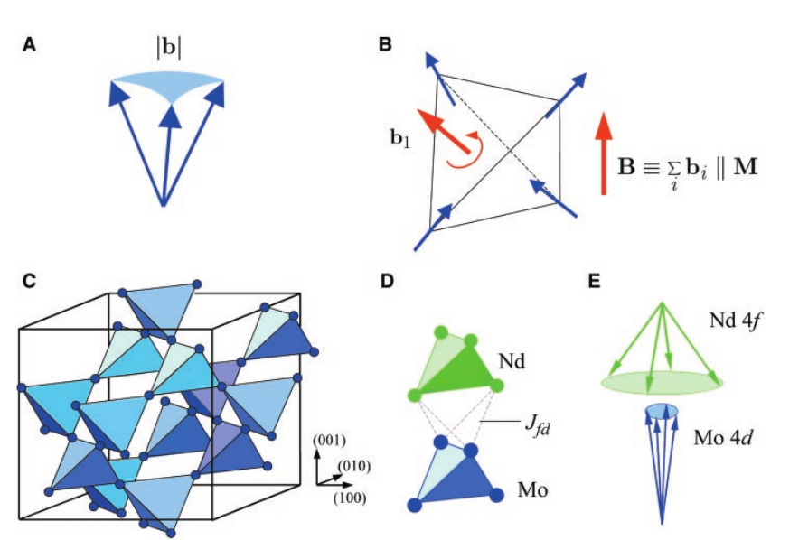
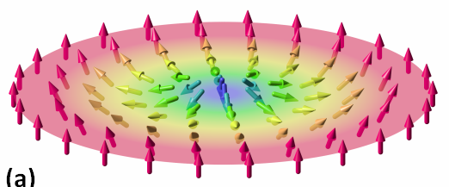
Also exists in skyrmions
Y. Taguchi et al., Science 291, 2573 (2001)

Slide 25
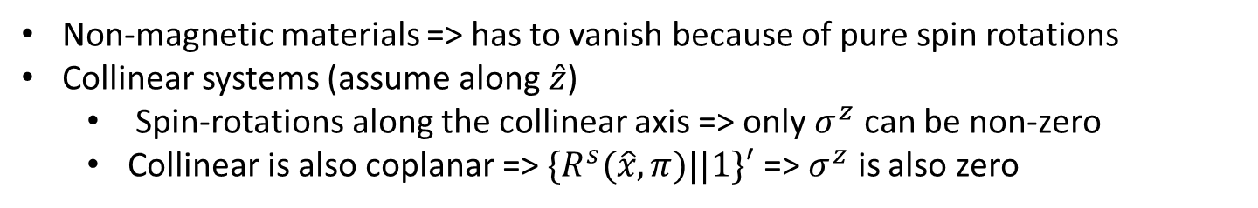
Spin-Hall effect
Spin current induced by electrical field
Most studied in non-magnetic materials
In high-symmetry materials the spin-current is transverse to the electric field
Time-reversal even
Symmetry without spin-obit coupling:
Non-magnetic materials => has to vanish because of pure spin rotations
Collinear systems (assume along $\hat{z}$)
  Spin-rotations along the collinear axis => only $σ^{z}$ can be non-zero
  Collinear is also coplanar => $\{R^{s}(\hat{x},π)||1\}′$ => $σ^{z}$ is also zero

Slide 26
In non-collinear (and coplanar) magnetic systems, spin-Hall effect can exist without spin-orbit coupling
Without SOC
With SOC
Yang Zhang et al, New J. Phys. 20 073028 (2018)

Slide 27
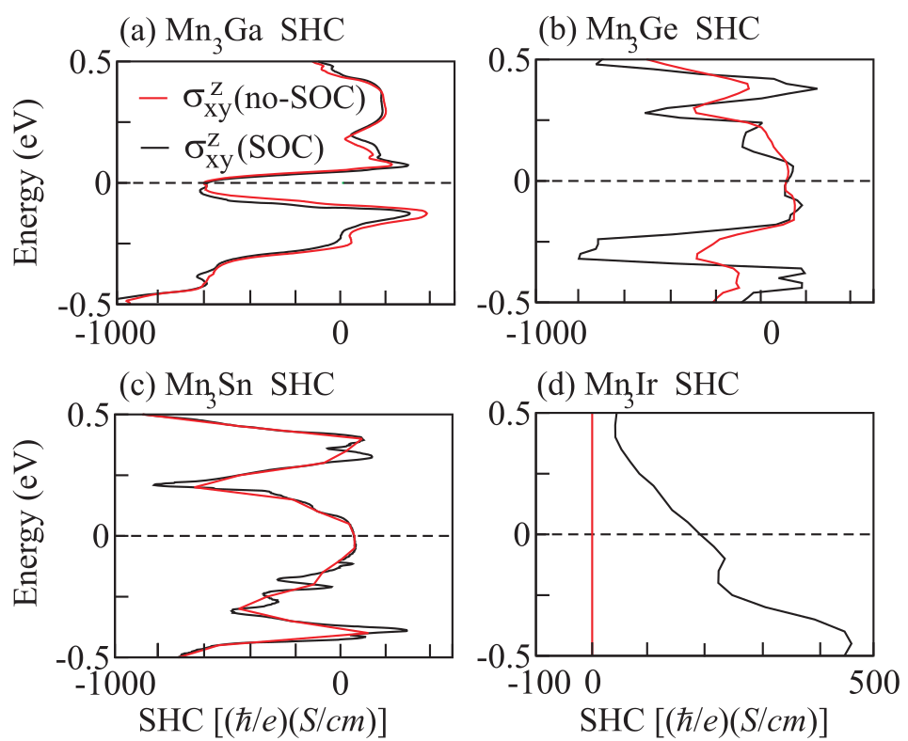
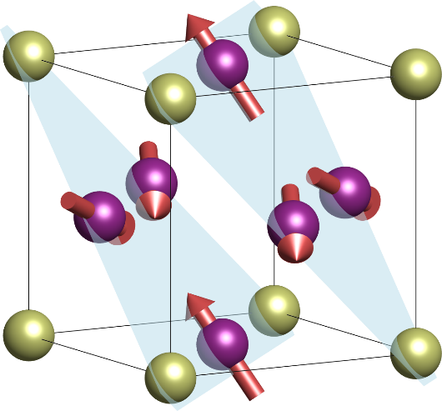
Spin-Hall effect calculation
Mn₃Ir
Non-relativistic contribution typically dominates

Slide 28
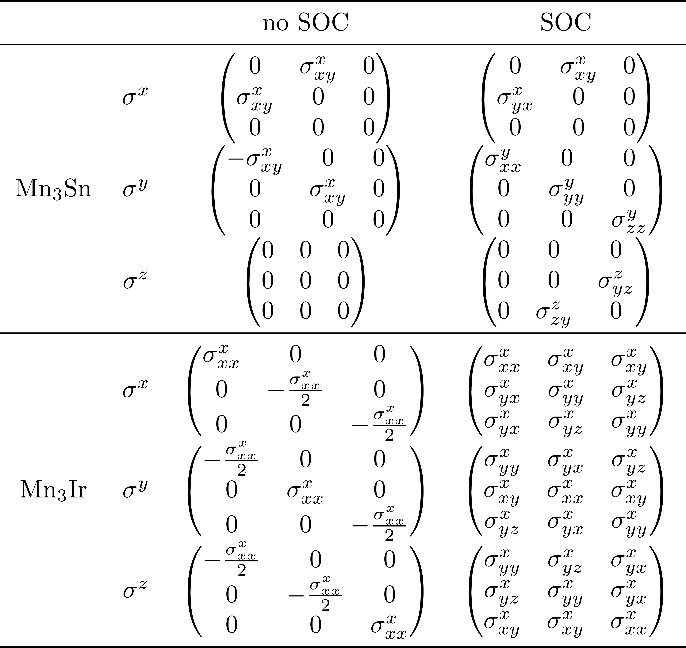
T-even spin-conductivity: contains dissipationless contributions
T-odd spin-conductivity: dissipative
Longitudinal spin current: spin-polarized current
Transverse current: magnetic spin-Hall effect

Slide 29
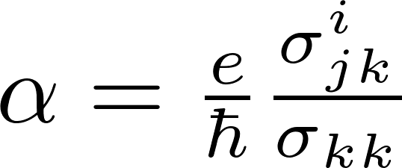


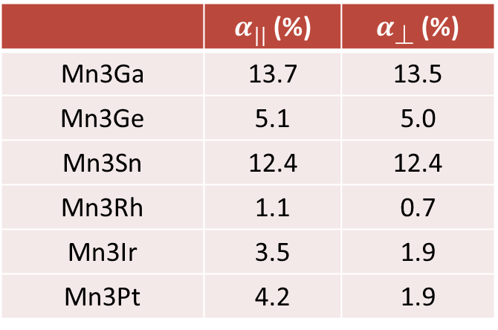
Mn₃Sn
Mn₃Ir
The odd spin currents depend strongly on disorder unlike the intrinsic spin Hall effect
Spin current angle:
Both large longitudinal and transverse spin currents present
 | $α_{||}$ (%) | $α_{}$ (%)
Mn3Ga | 13.7 | 13.5
Mn3Ge | 5.1 | 5.0
Mn3Sn | 12.4 | 12.4
Mn3Rh | 1.1 | 0.7
Mn3Ir | 3.5 | 1.9
Mn3Pt | 4.2 | 1.9
Spin currents are smaller than typically in ferromagnets, but still relatively large
In BCC Fe $α_{||}$ ∼ 18%
$α_{}$ ∼ 1%
Zelezny et al., arXiv:1702.00295
Notes:
Make a plot illustrating the different dependence on disorder of the odd and even spin currents

Slide 30
Magnetic interactions
Without spin-orbit coupling => All pure spin-rotations are symmetries of the non-magnetic system
Without spin-orbit coupling, in the lowest order only the isotropic Heisenberg exchange is allowed

Slide 31

Symmetry in the reciprocal space
Without spin-orbit coupling
What about antiferromagnets?
Spin-up
If PT symmetric => bands degenerate
Spin-down
$$\sim 1 eV$$
Non-magnetic
Ferromagnetic

Slide 32
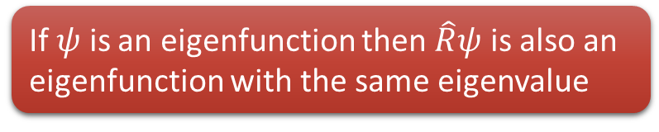

Symmetries in quantum mechanics
$\hat{R}$ symmetry ⬄ $\left[\hat{R},\hat{H}\right]=0$
If $ψ$ is an eigenfunction then $\hat{R}ψ$ is also an eigenfunction with the same eigenvalue
If non-degenerate then $ψ=\hat{R}ψ$

Slide 33
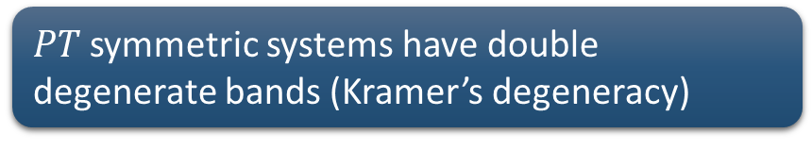
PT symmetric system
Due to antiunitarity
$PT$ symmetric systems have double degenerate bands (Kramer’s degeneracy)
$PTψ$ and $ψ$ are orthogonal and thus are distinct states

Slide 34
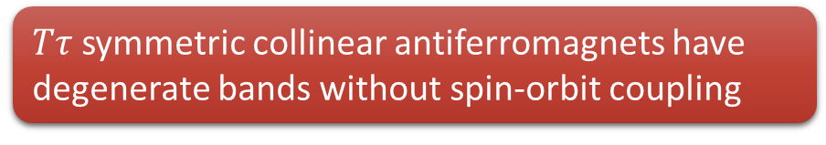

$Tτ$ symmetric antiferromagnets
$Tτ$ transforms $k→−k$ => does not result in band degeneracy
In coplanar systems without spin-orbit coupling $Tτ$ => $R^{s}\left(⊥{,180}^{∘}\right)τ$
$R^{s}\left(⊥{,180}^{∘}\right)τ$ transforms $k→k$, $S_{z}→−S_{z}$
In collinear system this is not possible with non-degenerate states
$Tτ$ symmetric collinear antiferromagnets have degenerate bands without spin-orbit coupling

Slide 35
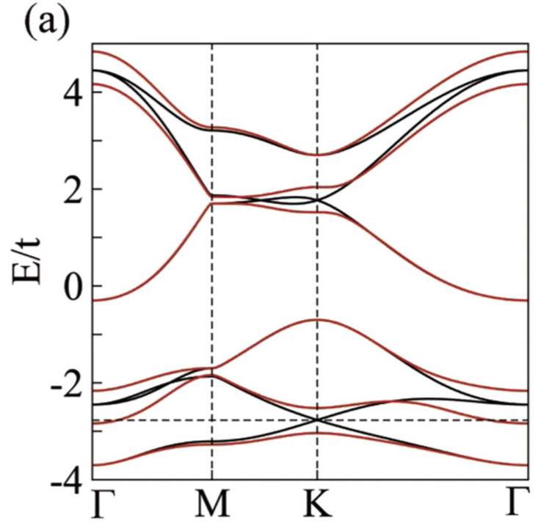
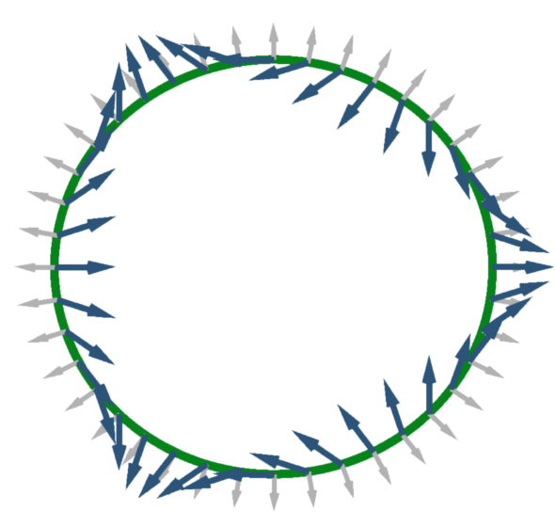
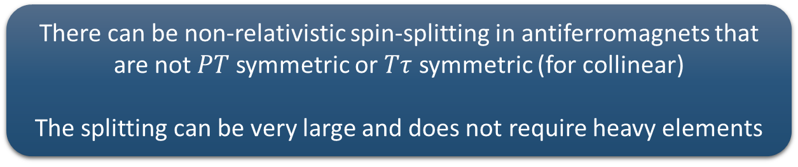
There can be non-relativistic spin-splitting in antiferromagnets that are not $PT$ symmetric or $Tτ$ symmetric (for collinear)
The splitting can be very large and does not require heavy elements
Without SOC
With SOC
velocity
k_{y}
spin
k_{x}
J. Železný et al., PRL 119, 187204 (2017)
Yang Zhang et al, New J. Phys. 20 073028 (2018)

Slide 36
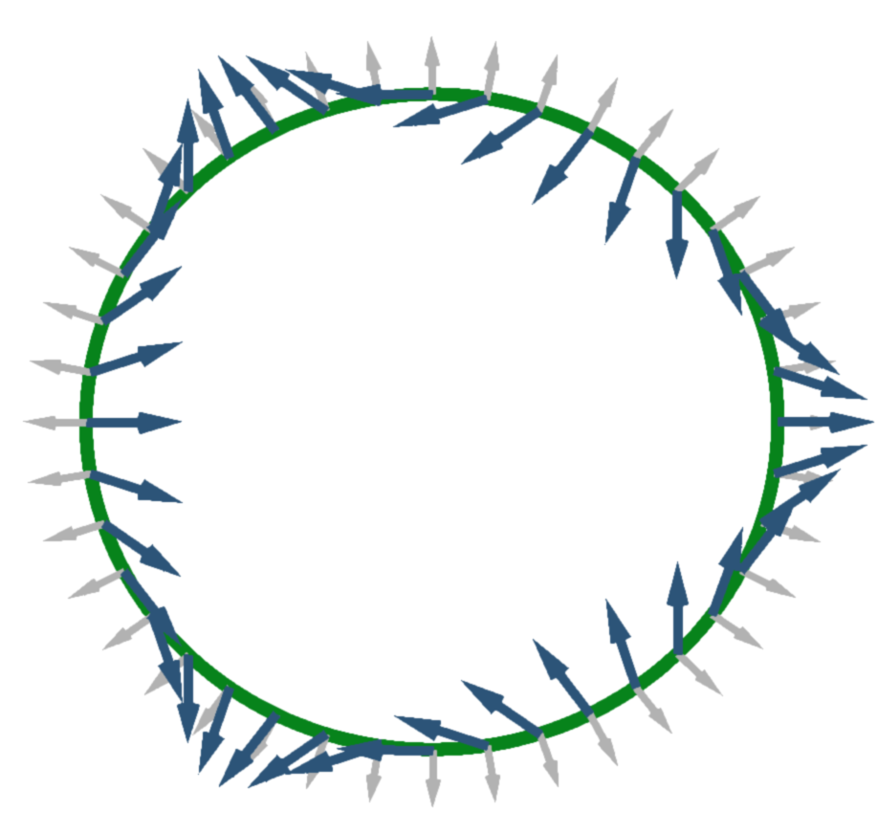
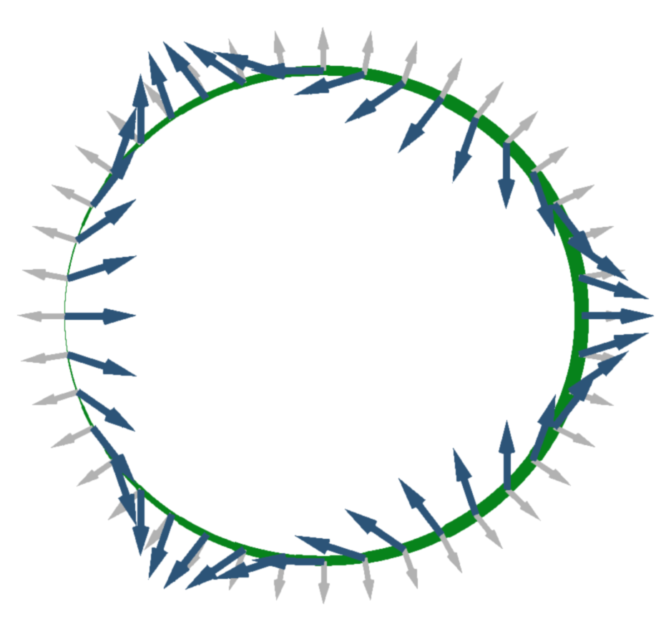

Spin current = spin $×$ velocity
E
k_{y}
k_{x}

Slide 37
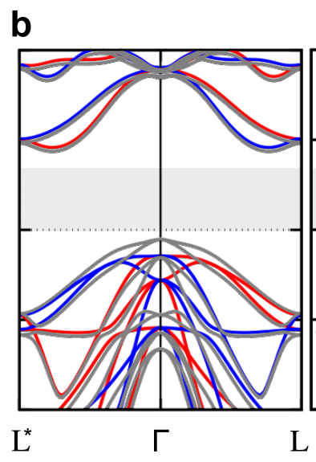
Many collinear antiferromagnets with non-relativistic spin-splitting have been identified
MnTe
L. Šmejkal et al., Phys. Rev. X 12, 011028 (2022)
Hayami, PRB 101, 220403(R) (2020)
Lin-Ding Yuan et al., PRM 5, 014409 (2021)

Slide 38
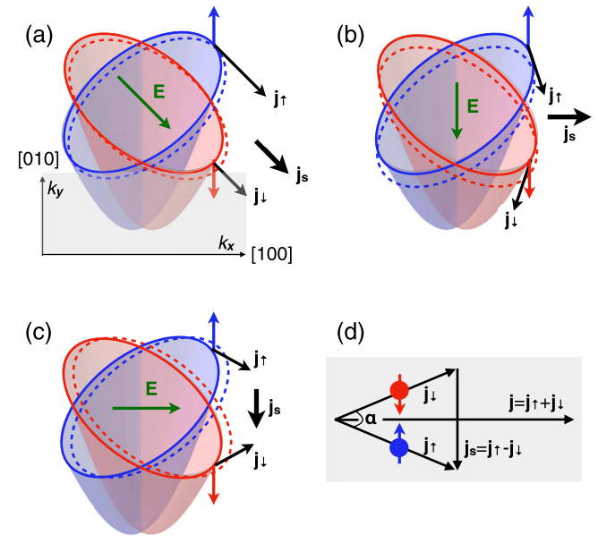
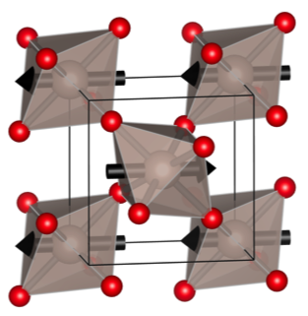
In collinear antiferromagnets there is k-dependent spin-splitting, but no spin-texture
RuO2
Spin conserving spin-charge conversion => spin-splitter
Hernandez et al., Phys. Rev. Letters 126, 127701 (2021)
L. Šmejkal et al., Phys. Rev. X 12, 011028 (2022).

Slide 39
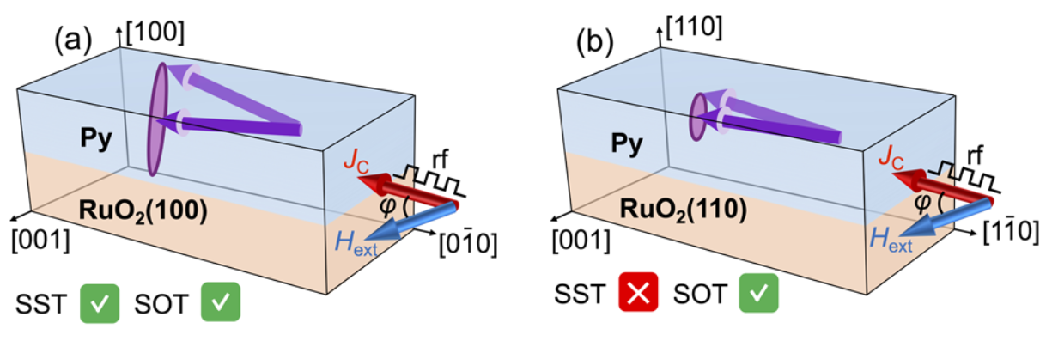
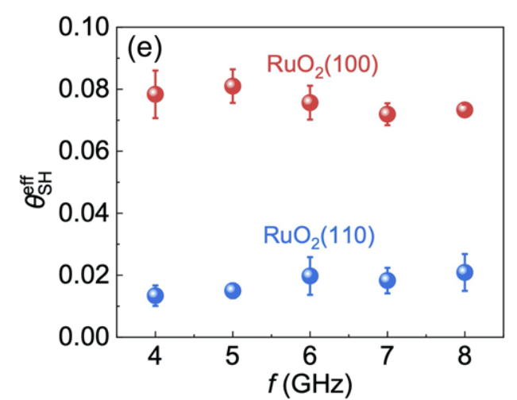
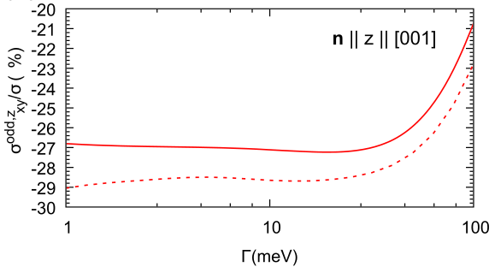
Spin-polarization of the current determined by the Néel vector
Several experimental observations
S. Karube et al., Phys. Rev. Lett. 129, 137201 (2022)
Calculation: very large spin current and spin current angle
A. Bose et al., Nature Electronics 5, 267–274 (2022)
H. Bai et al., Phys. Rev. Lett. 128, 197202 (2022).

Slide 40
Summary
Spin-orbit coupling
  Couples spin and orbital degrees of freedom => lowers symmetry
  In many systems it is small => symmetry without spin-orbit coupling is useful
Spin groups
  Symmetry without spin-orbit coupling is described by spin groups, which contain in addition to magnetic space groups symmetry operations also spin rotations
Applications of spin groups
  Non-relativistic spin Hall or anomalous Hall effects
  Non-relativistic spin splitting in the electronic structure

Slide 41
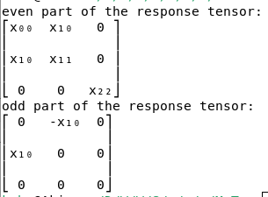
Symmetr
https://bitbucket.org/zeleznyj/linear-response-symmetry/
Python code that can directly do most of what is discussed in these lectures
Uses findsym to determine a list of symmetries for a given material
Can be installed with pip: ‘pip install symmetr’
Most features only work on Linux
Input file defining the crystal and magnetic structure
MnTe
0.00001
1
1.0 0.0 0.0
-0.5 0.866025403784439 0.0
0.0 0.0 2.0
2
P
4
Mn Mn Te Te
magnetic
0 0 0 1 3 0
0 0 0.5 -1 -3 0
0.333333 0.666667 0.75 0 0 0
0.666667 0.333333 0.25 0 0 0
Conductivity

