Slide 1
Principles and Applications of Symmetry in Magnetism Summer School
Jakub Železný

Slide 2
Symmetry of response (and other) tensor
  Transformations of tensors
  Time-reversal symmetry
  Tensor symmetrization
Beyond point groups
  Symmetry of local effects
  Equivalent magnetic configurations
  Expansions in magnetization
  Symmetry of magnetic interactions
Non-relativistic symmetry analysis
  How it works?
  Determining the non-relativistic symmetry operations
  What it’s used for?
Symmetr – a code for symmetry analysis

Slide 3

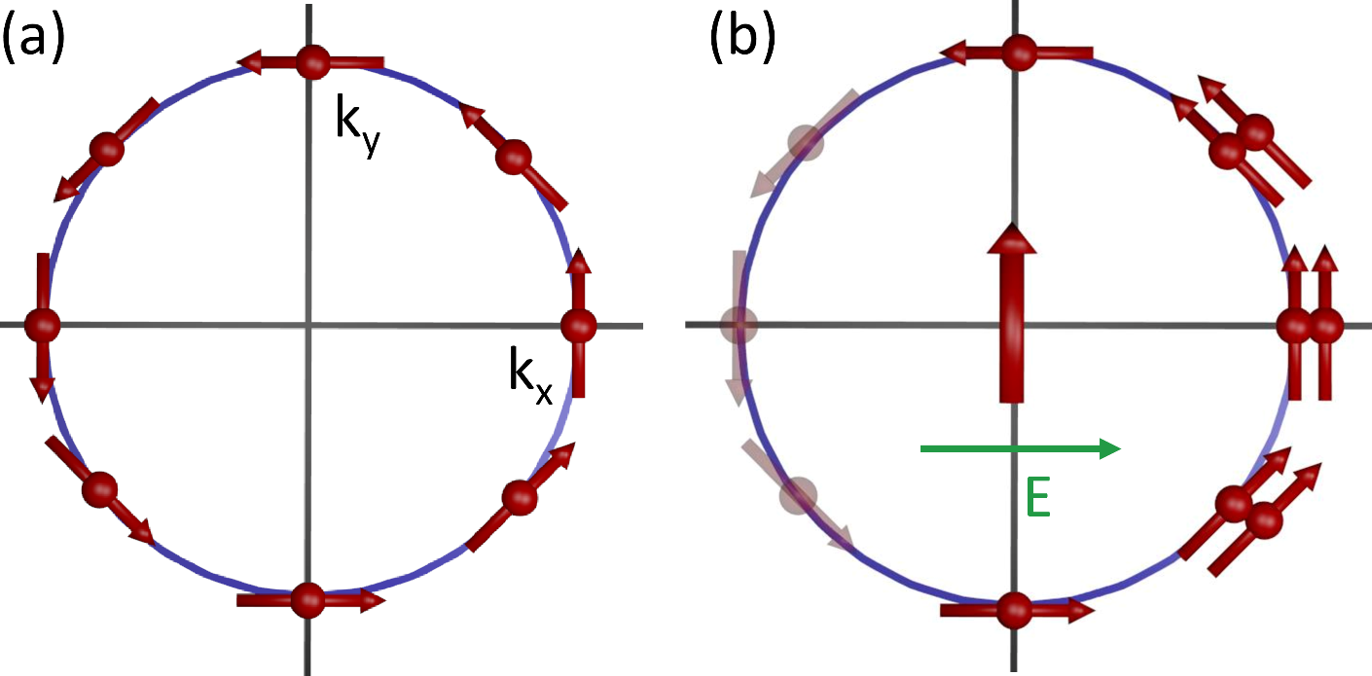
Edelstein effect (inverse spin-Galvanic effect, Magneto-electric effect)
Spin induced by electric field (current)

Slide 4



In magnetic materials the Edelstein effect generates a torque on the magnetic order => spin-orbit torque
Even under inversion
Odd under inversion
$χ$ is odd under inversion
Inversion symmetry must be broken

Slide 5
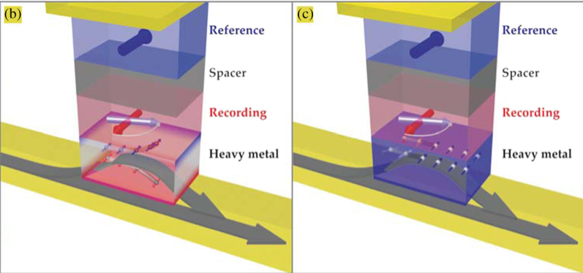
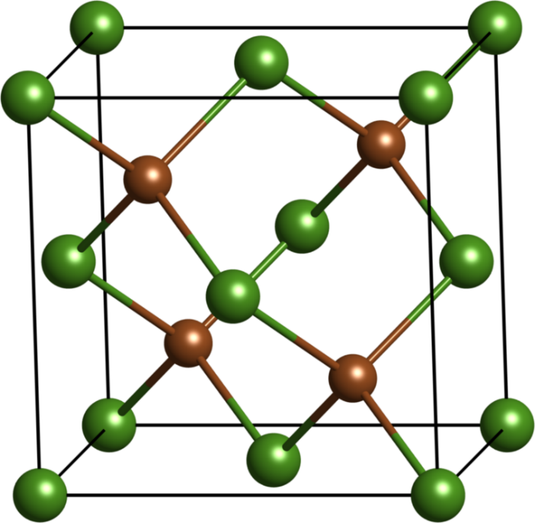
Inversion symmetry can be broken either by the crystal structure or by an interface
GaAs
Interfacial torque

Slide 6
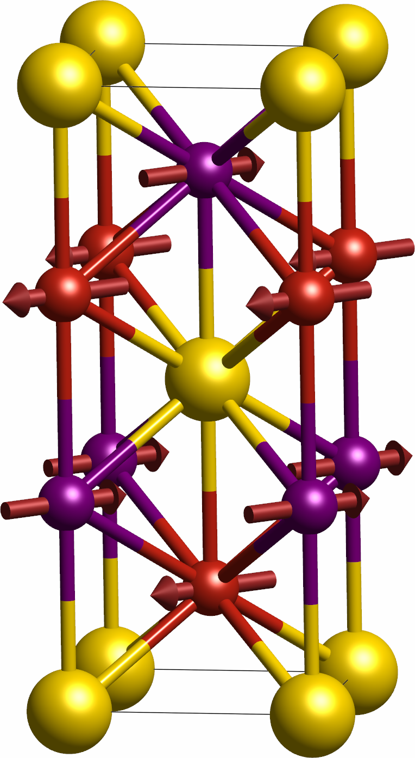
In antiferromagnets we are interested in Edelstein effect on each sublattice
We cannot use point group, but need the full space group
B
Large fields needed
Mn_{B}
Mn_{A}
B
B
Effective control
Mn₂Au

Slide 7
Body-centered lattice: only three non-equivalent sites
Mn_{B}
The tetragonal unit cell is the conventional unit cell => unlike the primitive cell it has the full symmetry of the lattice
Mn_{A}
Mn₂Au

Slide 8
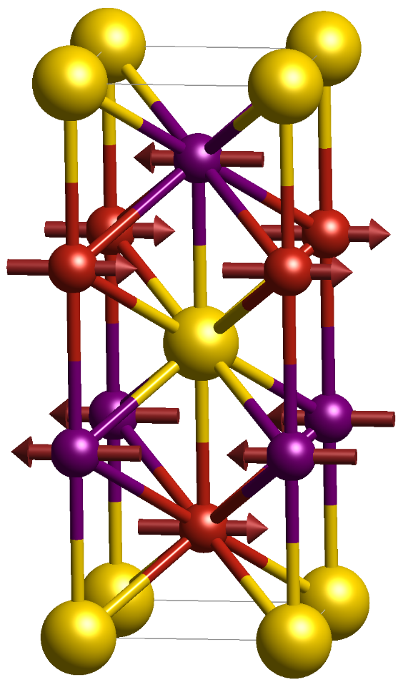
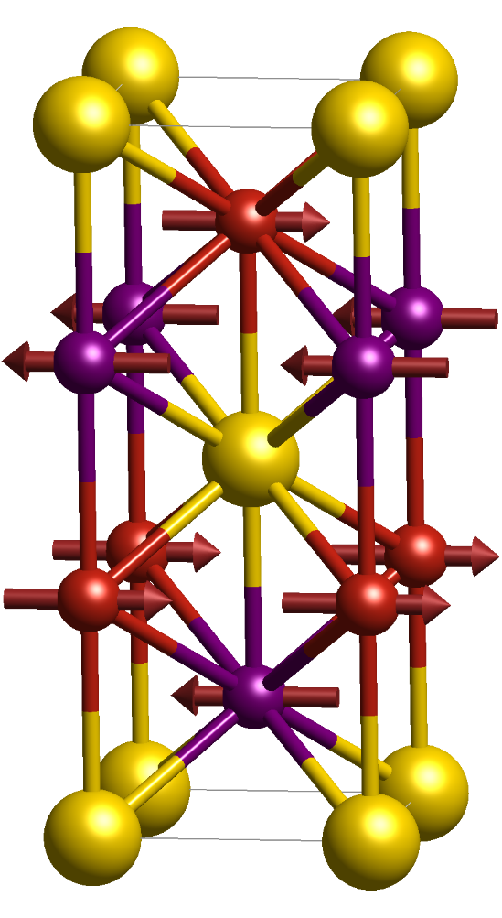
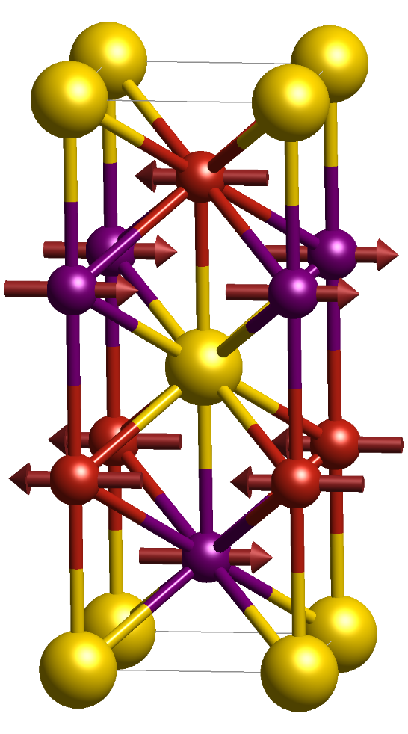
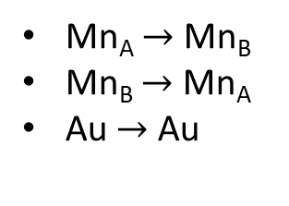
Inversion
Time-reversal
Inversion + Time-reversal (PT) is a symmetry of the system
Inversion transforms the atoms:
Mn_{A} $→$ Mn_{B}
Mn_{B} $→$ Mn_{A}
Au $→$ Au
Atomic permutations

Slide 9










For local effects we need to keep track of the permutations
PT transformation:

Slide 10

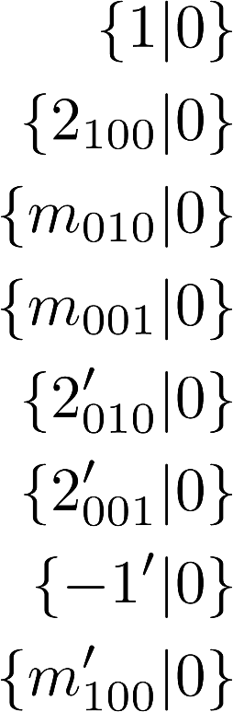
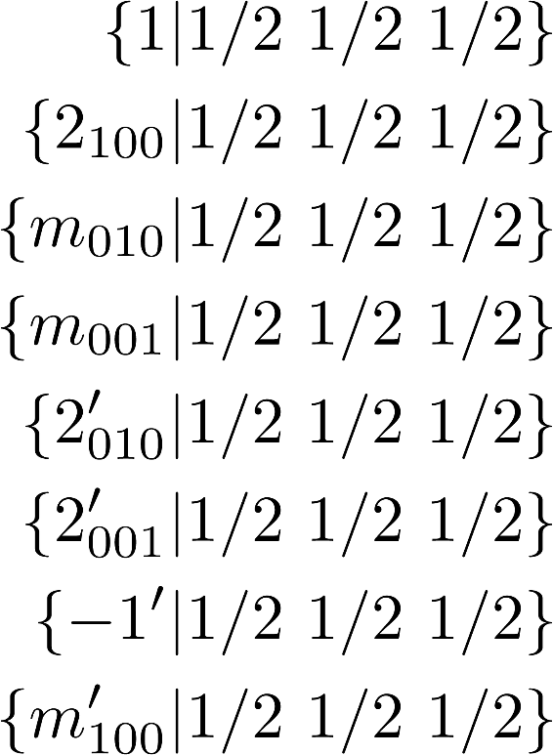

Symmetries that transform $A→B$ connect $χ^{A}$ and $χ^{B}$
Symmetries that transform $A→A$ restrict the form of $χ^{A}$
Given in a coordinate system such that:
Group of symmetries that keep A invariant => Site symmetry group
Mn₂Au group Im’mm:
These can be ignored

Slide 11
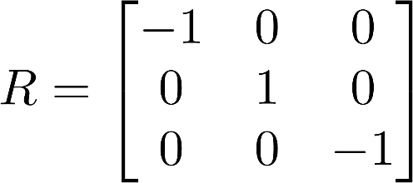

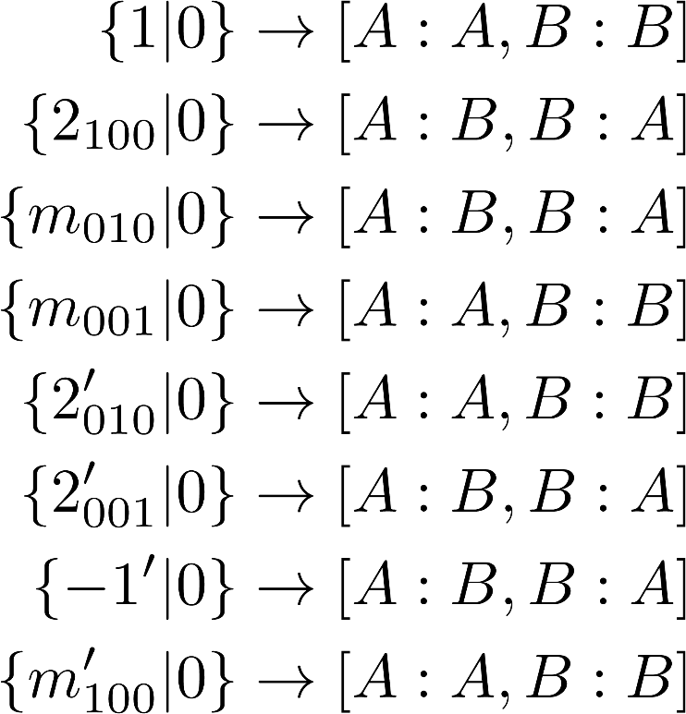

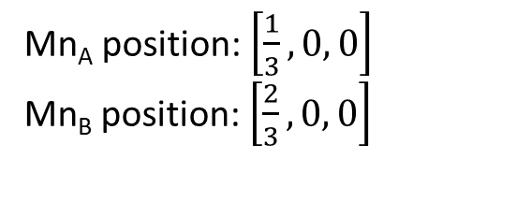
Rotation around y
Mn_{A} position: $\left[\frac{1}{3},0, 0\right]$
Mn_{B} position: $\left[\frac{2}{3},0, 0\right]$
$R\left[\frac{1}{3},0, 0\right]$ = $\left[−\frac{1}{3},0, 0\right]$
Mn_{A}, Mn_{B} site symmetry
m’2’m point group

Slide 12
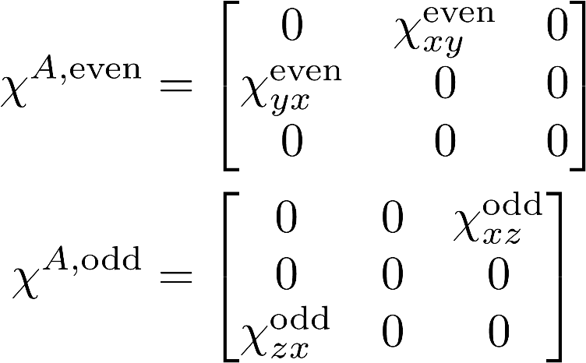
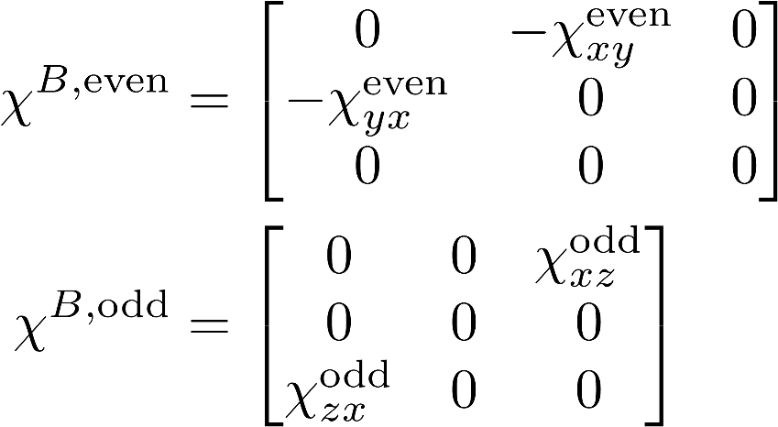
The symmetry of $χ^{A}$ can now be determined the same way as the global effects using the site symmetry group
Determined from PT, but we could equivalently use any other symmetry operation that connects Mn_{A} and Mn_{B}

Slide 13
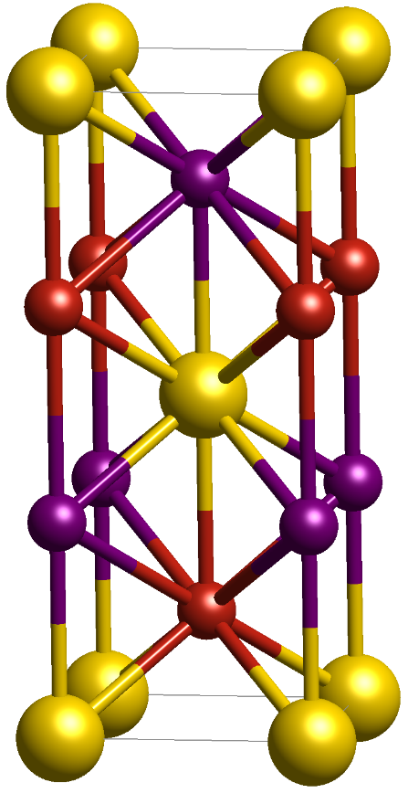
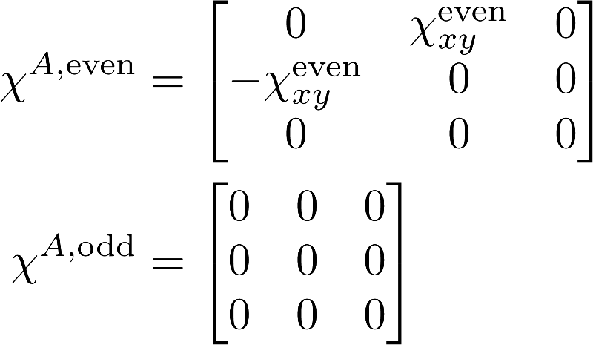
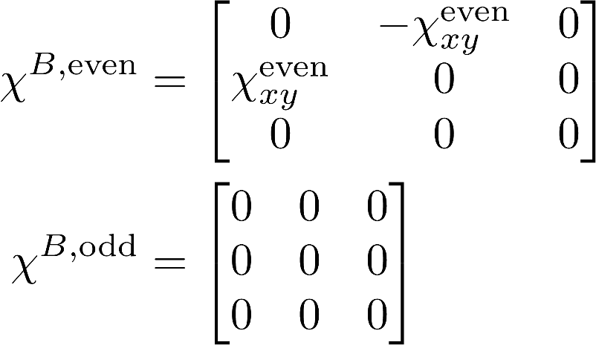
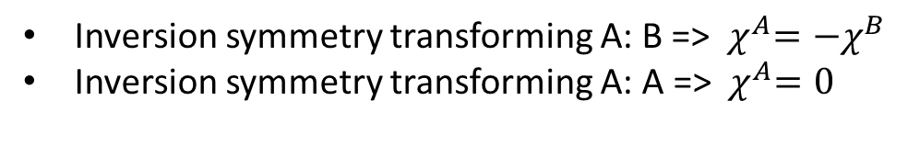
Inversion symmetry transforming A: B => ${ χ}^{A}=−χ^{B}$
Inversion symmetry transforming A: A => ${ χ}^{A}=0$
For local Edelstein effect local inversion symmetry breaking is necessary

Slide 14

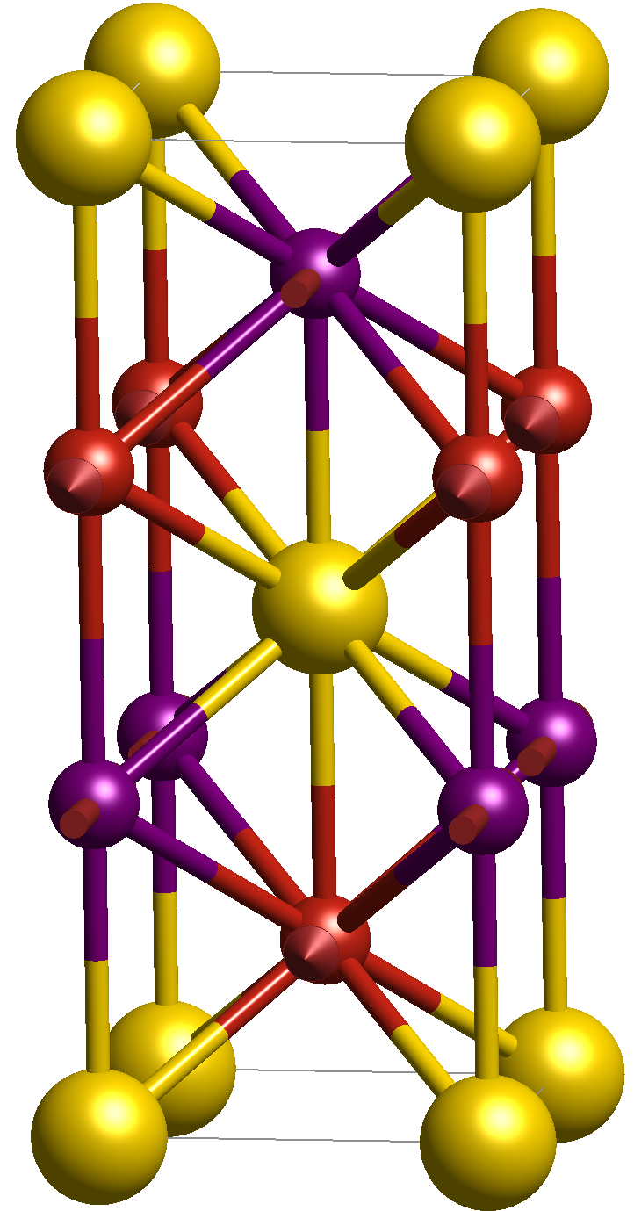

Moments along x
Moments along y
Different states, but symmetry related
Connected by $4_{z}$ - symmetry of the non-magnetic system, but not the magnetic one

Slide 15
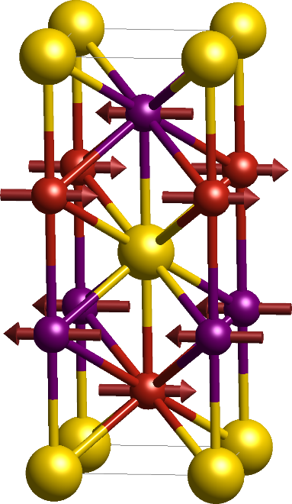
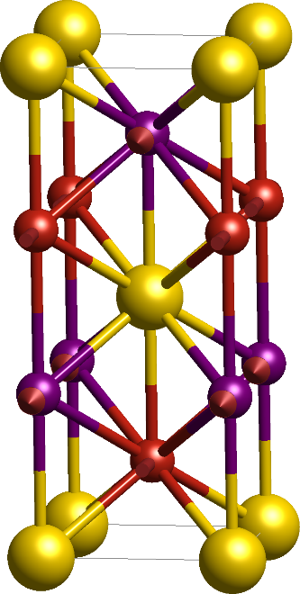
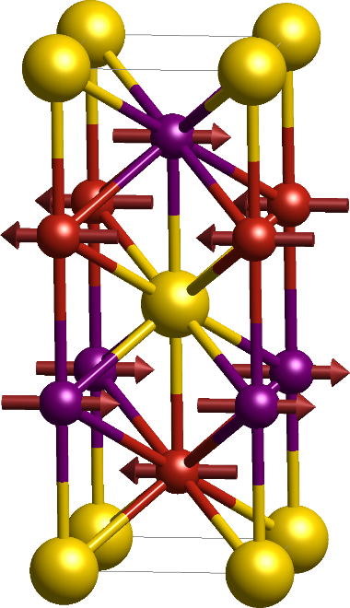

To identify the equivalent magnetic configurations, we transform the magnetic order using the symmetries of the non-magnetic lattice (including time-reversal)
Symmetry operation $R$ with site permutation $p$
Corresponds to possible magnetic domains

Slide 16
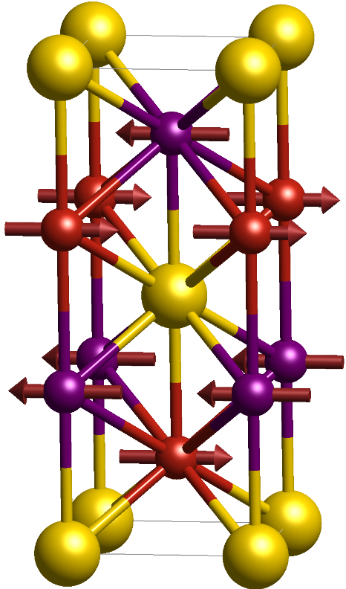

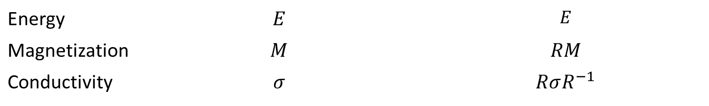


$$R$$
All physical properties are connected by $R$
Energy | $$E$$ | $$E$$
Magnetization | $$M$$ | $$RM$$
Conductivity | $$σ$$ | $$RσR^{−1}$$

Slide 17



Time-reversal is always symmetry of the system without spin-orbit coupling
States with flipped moments are always connected by time-reversal
$$T$$

Slide 18
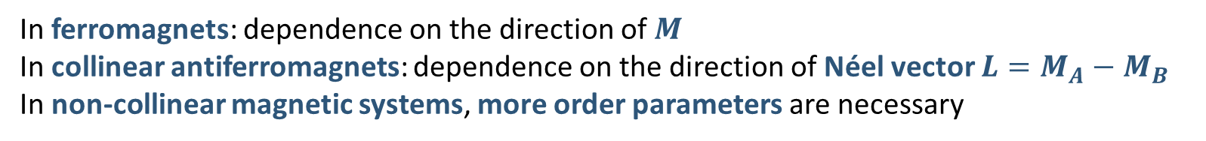
We are often interested in the dependence of system properties on the magnetic order orientation
In ferromagnets: dependence on the direction of $M$
In collinear antiferromagnets: dependence on the direction of Néel vector $L=M_{A}−M_{B}$
In non-collinear magnetic systems, more order parameters are necessary
Assuming that the exchange is large any dynamics of the magnetic order corresponds to a rotation of all moments and small canting

Slide 19




What can we say about this dependence from symmetry?

Slide 20
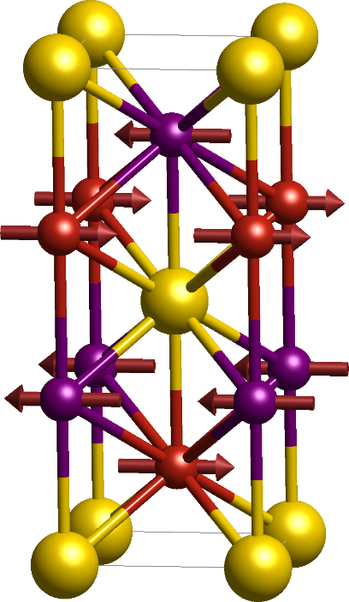
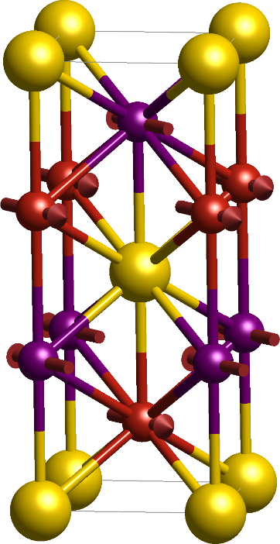
Only specific direction are connected by symmetry, for general orientations no symmetry relation exists
We can find approximate relations

Slide 21
Simple ferromagnets
Expand properties of interest in powers of M:
Expansion coefficients are tensors, which can be symmetrized the same way as other tensors using the non-magnetic symmetry operations
Such expansions usually work quite well because the dependence on the orientation is due to spin-orbit coupling, which tends to be small

Slide 22





Symmetry $R$:
Must hold for all terms of the expansion
$R$ rotation:
Transpose $R_{kp}^{−1}$and $R_{lq}^{−1}$
Rename $k↔p, q↔l$
Must hold for all $M_{k}$ and $M_{l}$

Slide 23

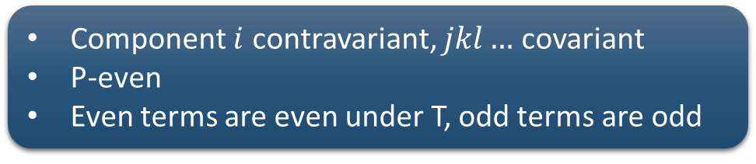
Component $i$ contravariant, $jkl…$ covariant
P-even
Even terms are even under T, odd terms are odd
In general:
Transforms as $χ_{ijk…}$
Covariant
P-even
T-even for even terms, T-odd for odd terms

Slide 24

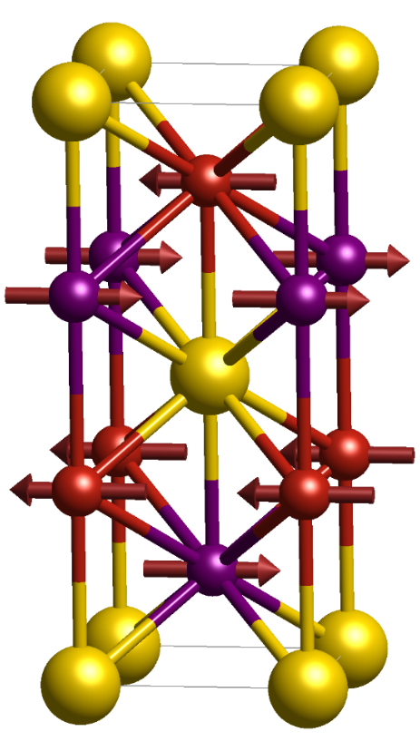


Antiferromagnets (and more complex magnets in general)
$L$ does not transform the same as $M$
$$PT$$
We need to keep track of the permutations

Slide 25
Define L transformation matrix:
May not always be possible!

Slide 26

Unit cell
Unit cell
These two states are also symmetry related but not dot correspond to rotation of the $L$ vector

Slide 27

Example: Edelstein effect in Mn₂Au
Mn_{B}
Field-like torque
Mn_{A}
Since we are considering a local effect: $L\sim M_{A}$
For in-plane electric field and assuming $χ_{xxz=}χ_{zxx}$
Anti-damping torque
J. Železný et al., $PRB 95, 014403 (2017)$

Slide 28
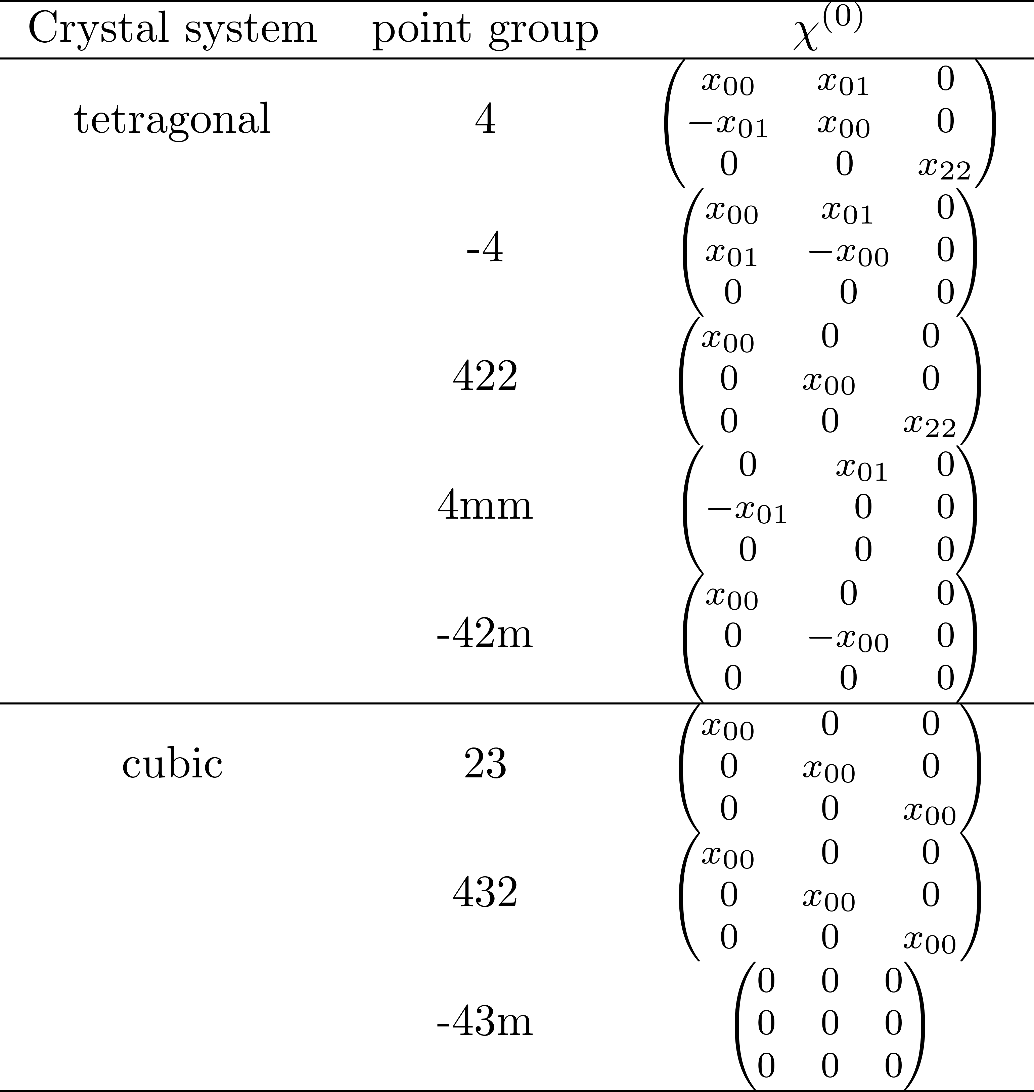
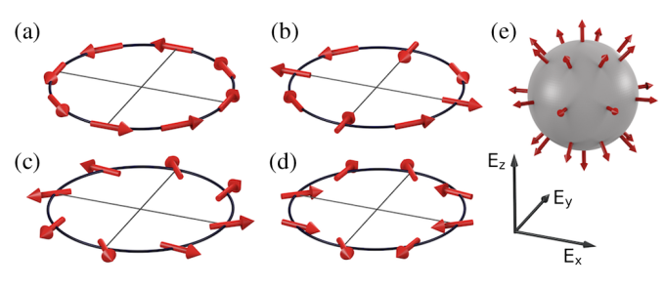
Classification of field-like (0th order) Edelstein effect
Rashba
Dresselhaus
Weyl
J. Železný et al., PRB 95, 014403 (2017)

Slide 29


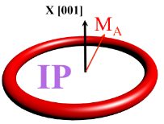
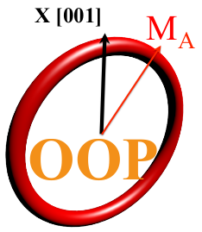

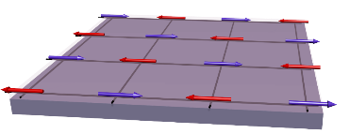
Even
Odd
B_{y} J||x
B_{z} J||x
B_{x} J||x
B_{z} J||y
B_{y} J||y
B_{x} J||y
B_{z} J||y
B_{x} J||x
B_{y} J||y
Zelezny et al., PRL 113, 157201 (2014)
J. Železný et al., PRB 95, 014403 (2017)

Slide 30
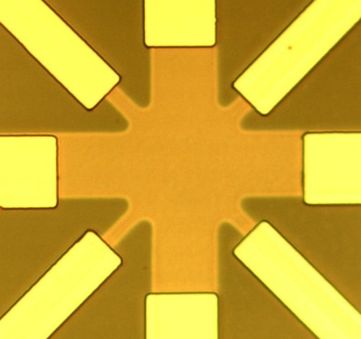
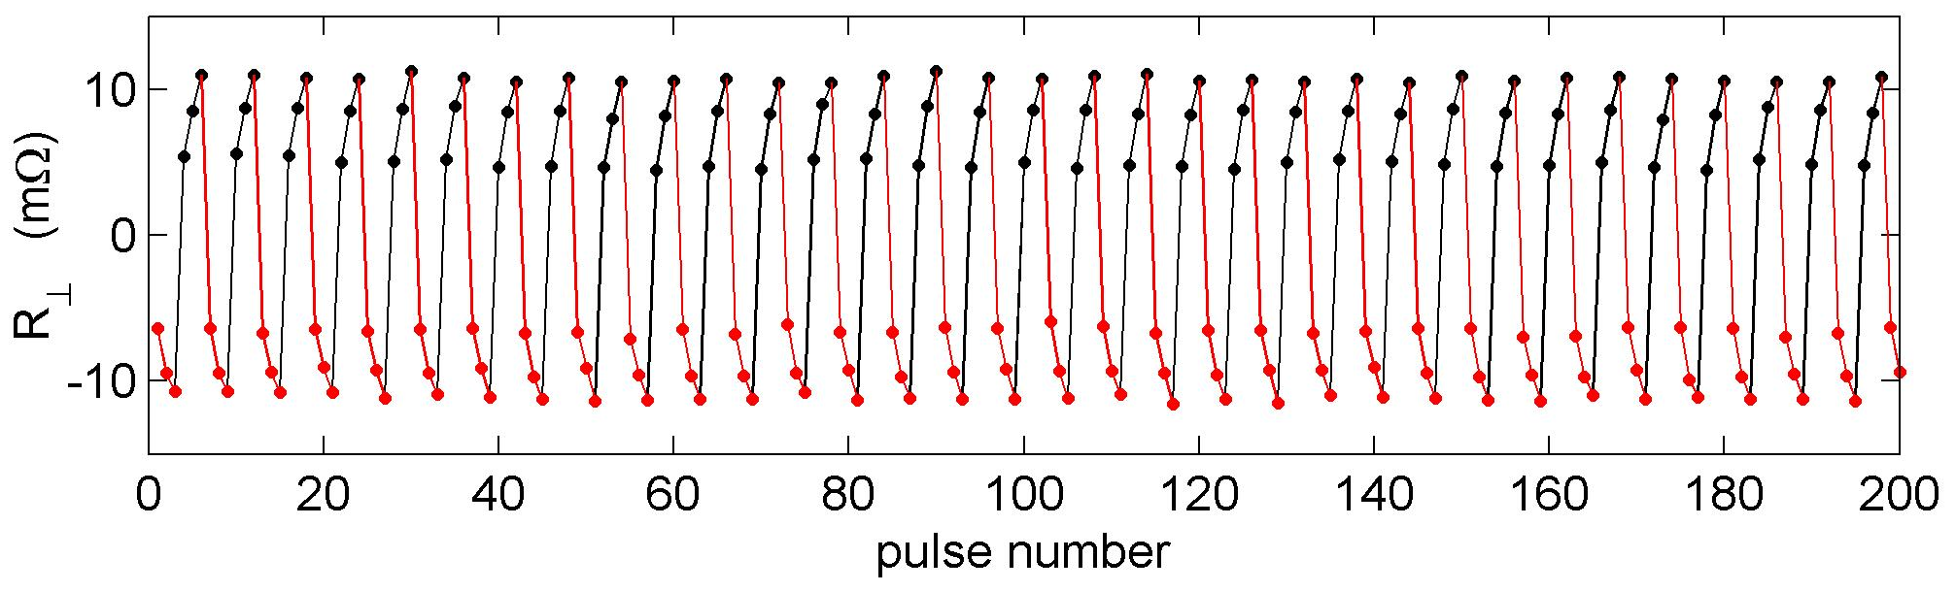
Spin-orbit torque switching experimentally observed in CuMnAs and Mn₂Au
J_{write}
+
[010]
[100]
J_{write}
-
30 μm
J_{read}
R
T
P. Wadley et al., Science (2016)
DOI: 10.1126/science.aab1031

Slide 31
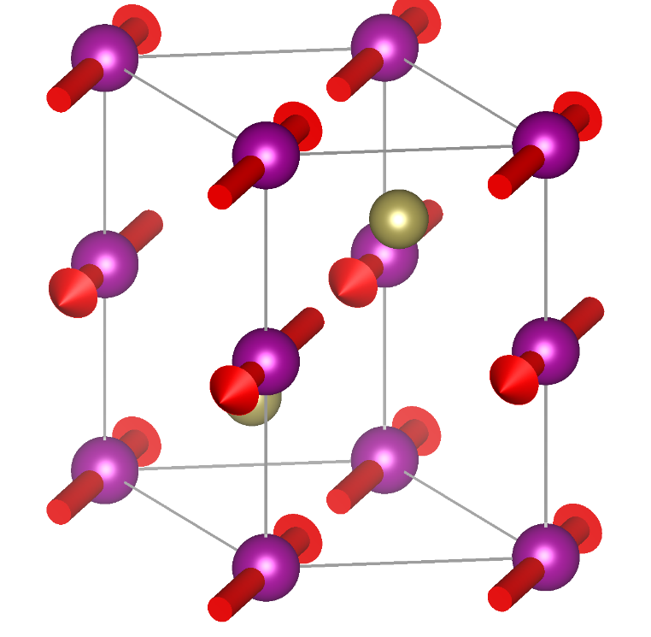
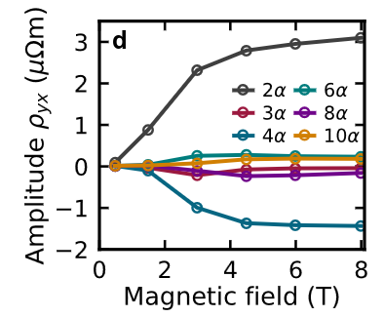
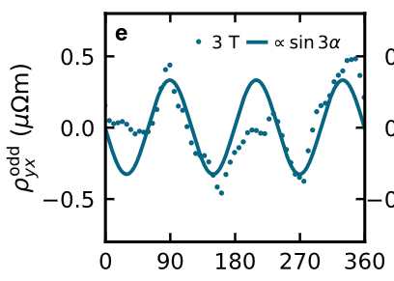
Anisotropic magnetoresistance (AMR) in MnTe
AMR is dependence of $σ^{even}$ on the magnetic order
Expansion of conductivity up to 6th order in L
Anomalous Hall effect

Slide 32
Symmetry of magnetic interactions
Magnetic interactions are commonly described by a semi-classical Hamiltonian
Simple example:
Heisenberg exchange
Uniaxial anisotropy
In general:
Tensors

Slide 33


How does H transform?
$R$ symmetry of the non-magnetic crystal: transforms $M$ as
Must hold for all expansions terms
$$R:A→A, B→B$$
$$R:A→B, B→A$$

Slide 34
Additional constraint: Indices corresponding to the same moment must be symmetric

Slide 35
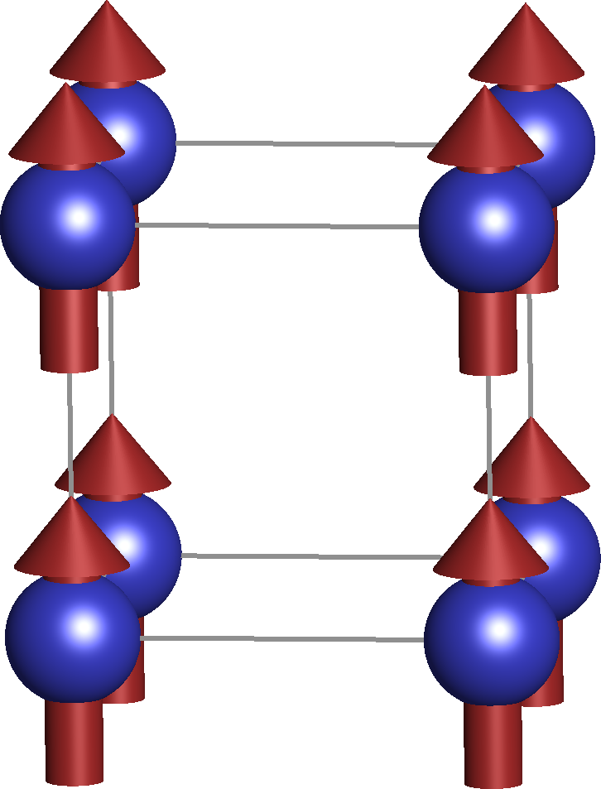
Cubic ferromagnet
Corresponds also to interactions between different unit cells
Isotropic Heisenberg exchange
Only one site
Constant!

Slide 37
Example: Mn2Au
Mn_{B}
Normal exchange, but anisotropic due to the tetragonal symmetry
Mn_{A}

Slide 38

Example: Mn2Au
Mn_{B}
Mn_{A}
Assume: $|\left|M\right||=1$
Uniaxial anisotropy along the z-axis
Because the expansion coefficients are not independent we can get 0th order terms in the 2nd order expansion, etc.

Slide 39
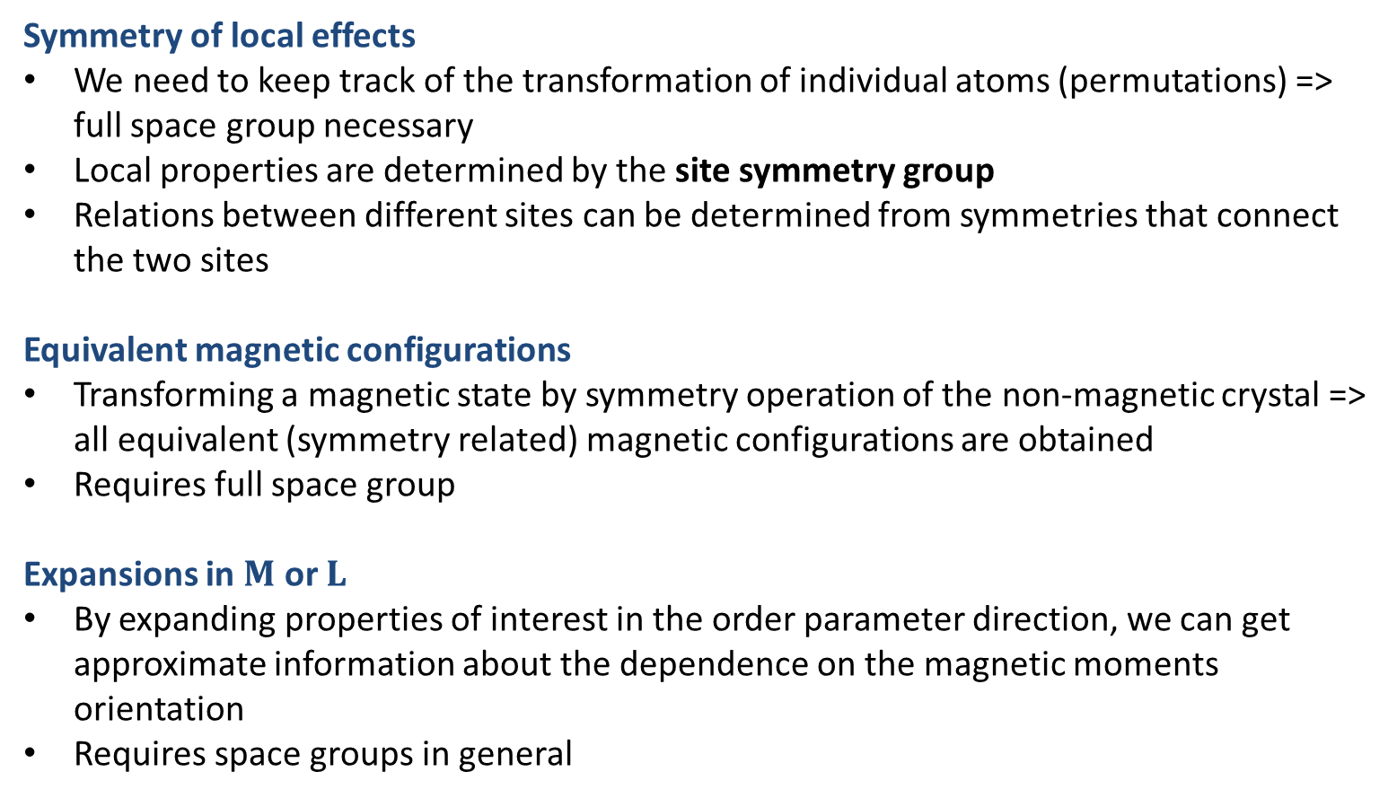
Summary
Symmetry of local effects
We need to keep track of the transformation of individual atoms (permutations) => full space group necessary
Local properties are determined by the site symmetry group
Relations between different sites can be determined from symmetries that connect the two sites
Equivalent magnetic configurations
Transforming a magnetic state by symmetry operation of the non-magnetic crystal => all equivalent (symmetry related) magnetic configurations are obtained
Requires full space group
Expansions in $M$ or $L$
By expanding properties of interest in the order parameter direction, we can get approximate information about the dependence on the magnetic moments orientation
Requires space groups in general

