Slide 1
Principles and Applications of Symmetry in Magnetism Summer School
Jakub Železný

Slide 2
Symmetry of response (and other) tensor
Transformations of tensors
Time-reversal symmetry
Tensor symmetrization
Beyond point groups
Symmetry of local effects
Equivalent magnetic configurations
Expansions in magnetization
Symmetry of magnetic interactions
Non-relativistic symmetry analysis
How it works?
Determining the non-relativistic symmetry operations
What it’s used for?
Symmetr – a code for symmetry analysis
zeleznyj@fzu.cz

Slide 3
Neumann's principle
If a crystal is invariant with respect to certain symmetry operations, any of its physical properties must also be invariant with respect to the same symmetry operations.
Curie laws
the asymmetry of the effects must pre-exist in the causes;
the effects may be more symmetric than the causes.
‘asymmetry creates the phenomenon’
Physical phenomena are due to absence of symmetries

Slide 4
What is symmetry?
Transformation that leaves the system invariant
System invariant under 90º rotation
E
E
J
J

Slide 5
How does the conductivity tensor transform?
E
Conductivity tensor:
J
Rotate the whole system by R:
E
J

Slide 6
If R is symmetry:
A set of linear equations for components of tensor $σ$

Slide 7
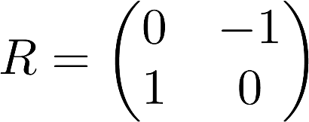
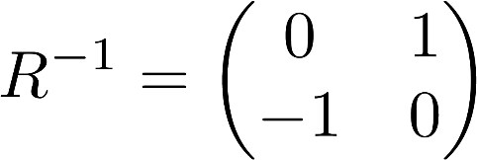
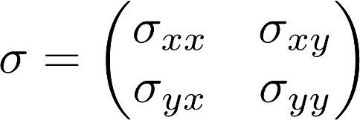
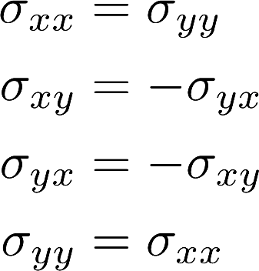
90 degree rotation around the z-axis
Two free parameters

Slide 8
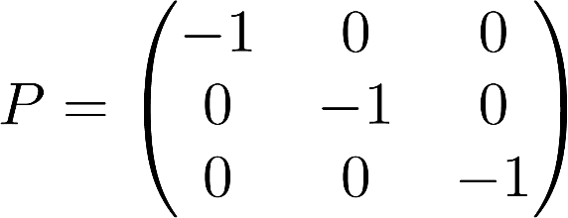
What kind of symmetry operations can we have?
Non-magnetic systems (230 crystallographic space groups):
Rotations (2-fold, 3-fold, 4-fold, 6-fold)
Translations
Spatial inversion
2-fold rotation + inversion = mirror
rotation + inversion = improper rotation (rotoinversion, rotation-reflection)
rotation + translation = screw axis
Magnetic systems (1651 magnetic space groups):
Rotations (2-fold, 3-fold, 4-fold, 6-fold)
Translations
Spatial inversion
Time-reversal

Slide 9
Point groups
Global phenomena are invariant under translations => we can remove translations from the space group
Group Pnc2:
Point group mm2:
32 non-magnetic point groups
122 magnetic point groups

Slide 10
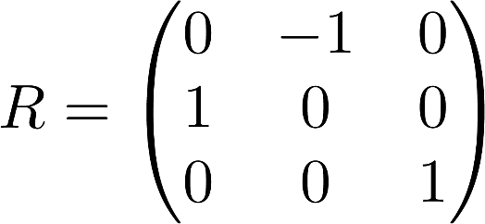
Representing symmetries
Symmetries correspond to some real space transformation
For example $4_{z}$
In quantum mechanics it is represented by a quantum operator, that acts on the wavefunction:
$\hat{J}$ is an angular momentum operator
$\hat{U}$unitary operator:
Noether’s theorem:
Continuous symmetries
Conserved quantity
Rotation
$\hat{J}$

Slide 11
Time-reversal symmetry in classical mechanics
Time-reversal symmetry in quantum mechanics
Reversing time is equivalent to complex conjugation:
Also can be seen from the canonical commutation relations:

Slide 12
Time-reversal must anti-commute with spin:
This would not hold for just complex conjugation
y Pauli matrix
Complex conjugation
Regular symmetry operations are represented by unitary linear operators:
Time-reversal is anti-unitary:

Slide 13
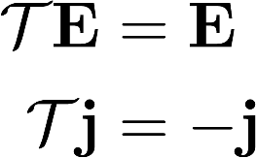
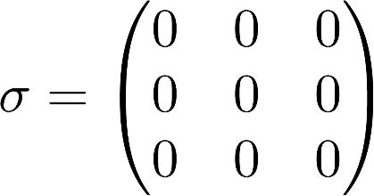
How do we use time-reversal?
E
Consider time-reversal invariant system (non-magnetic)
J
Naively we would expect:
We cannot actually reverse time in the experiment
The laws of physics are not invariant under time-reversal

Slide 14
The laws of physics are not invariant under time-reversal (but only for weak interactions)
Not a problem for us => condensed matter physics is controlled by the electromagnetic interaction, which is T-invariant
Symmetry breaking in condensed matter physics means that the physical laws are invariant under the symmetry, but the ground state is not (spontaneous symmetry breaking)

Slide 15
Start with microscopic formulas
Simplest expression for conductivity:
Velocity operator
Band index
Mean value => real

Slide 16
Another component exists: Anomalous Hall effect
So-called intrinsic formula
AHE can only exist in materials that breake time-reversal symmetry (typically magnetic)

Slide 17
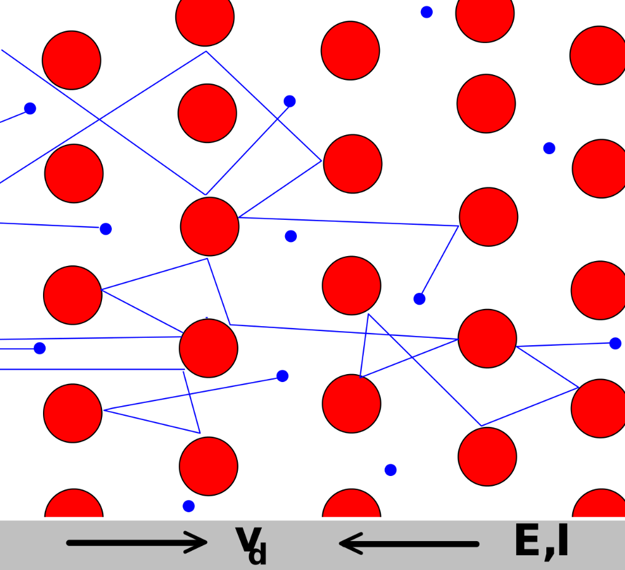
In non-magnetic material, the electrical current is unchanged under time-reversal
Electrical current is a dissipative, irreversible process
Time-reversal does not reverse microscopic particle trajectories
AHE transforms in the “natural” way => can in fact be dissipationless

Slide 18
In general, there are two components T-even and T-odd:
Applies to any response tensor
Vector of all magnetic moments of the system
External magnetic field

Slide 19
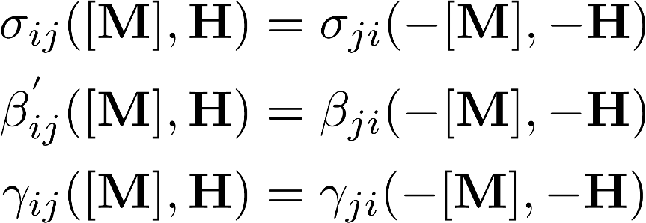
Onsagers reciprocity relations
Charge and thermal currents in presence of electric field and thermal gradient
Conductivity is symmetric tensor, AHE is anti-symmetric
H. Grimmer, Acta Cryst. A49, 763-771 (1993)

Slide 20
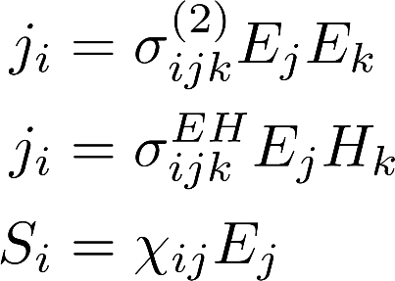
General response tensors
For symmetrization we need to know how they transform => can be determined in the same way as the conductivity
Translations: we only consider global phenomena for now => translations can be ignored
Time-reversal: Split the tensor into T-even and T-odd parts
We only need to determine the transformation under rotations and inversion

Slide 21
Rotation R:
l is a covariant component
k is a contravariant component
This is true in general
l is a covariant component
m,n are contravariant components
In a cartesian coordinate system (orthonormal basis):
In general, this is not true!

Slide 22
Inversion P:
Each component is typically even or odd under inversion => the whole tensor can either be even or odd under inversion
P-odd
P-odd
The whole tensor is P-even

Slide 23
Time-reversal T:
For equilibrium or dissipationless phenomena using the “normal” way
Otherwise split into even and odd parts:

Slide 24
How to do the symmetrization?
Global phenomena => point group is sufficient
Effects invariant under inversion => Laue groups (add or remove inversion to all symmetries)
Sufficient to only consider generators
A subset of the group such that the whole group can be obtained from products of the generators and their inverse

Slide 25
How to do the symmetrization?
Sufficient to only consider generators

Slide 26
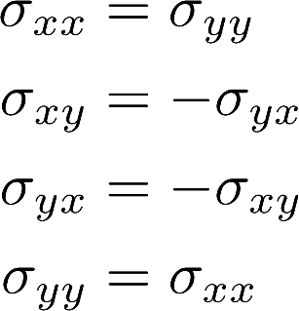
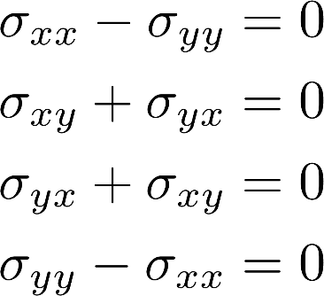
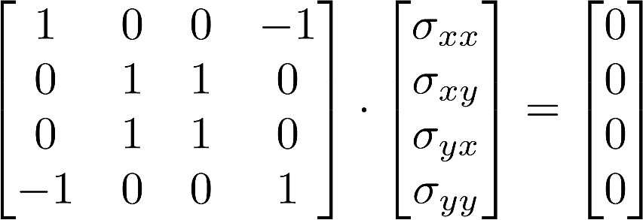
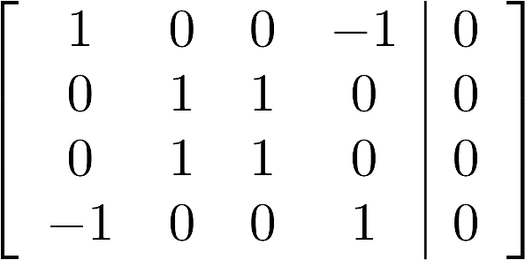
How to do the symmetrization?
We have to solve a system of linear equations
Use Gaussian elimination

Slide 27
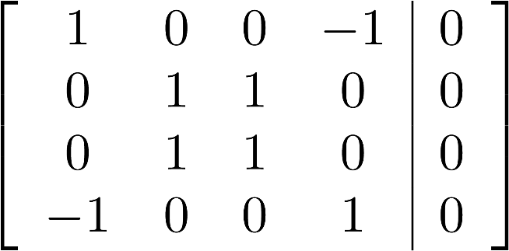
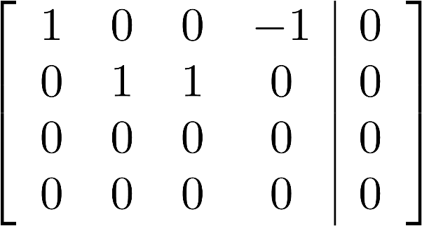
Convert to reduced row echelon form
This has infinitely many solutions
Echelons correspond to variable that can be eliminated

Slide 28
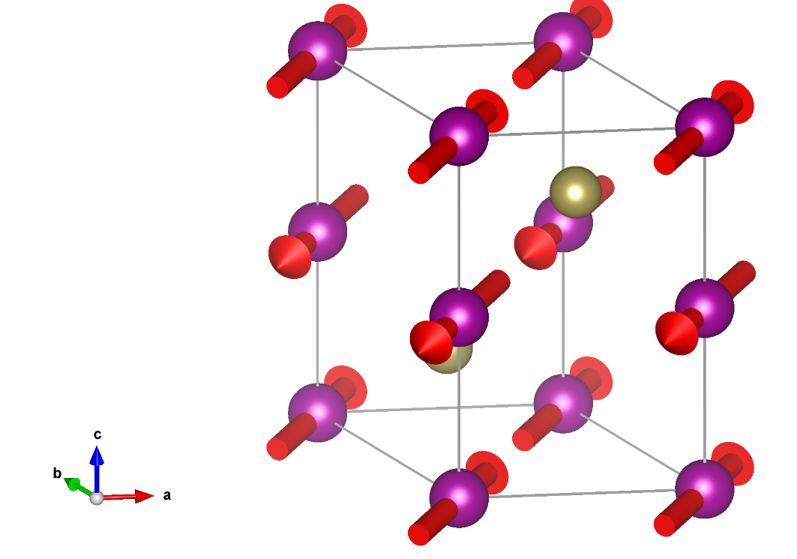
More complicated example: MnTe
Space group: Cmcm (#63.457)
Point group: mmm.1
Symmetry operations of the point group:
Rotations:
Mirrors:
Inversion:
Generators:
Rotations:
Inversion:
b
b’
a’
c
a
For conductivity we can ignore the inversion
c’
Conventional coordinate system of the non-magnetic lattice
Conventional coordinate system of the magnetic lattice

Slide 29
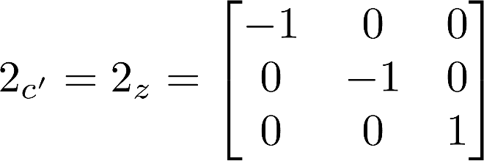
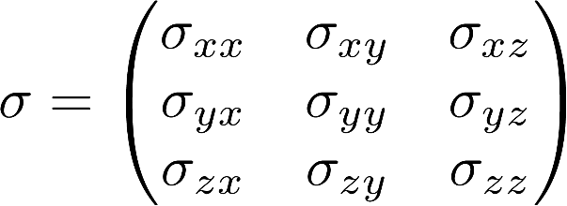
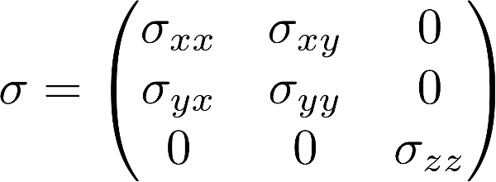
b
b’
a’
y
We use cartesian coordinate system
c
a
c’
z
x
Alternatively, use symmetries in the conventional coordinate system and transform back

Slide 31
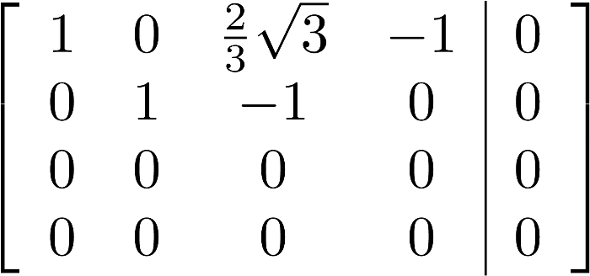
Convert to reduced row echelon form

Slide 32
Numerical symmetrization
Gaussian elimination is numerically not well behaved
We need to find the null space of Y
Solution is either $x=0$ or it has infinitely many solutions
Singular values
We use singular value decomposition
$U,V$ real unitary (orthogonal) matrices
$Σ$ diagonal
The rows of $V^{T}$ corresponding the zero singular values of $Σ$ give the null space

Slide 33
Singular values
$a_{1},a_{2}…$ basis of the null space
We use Gaussian elimination to convert this to reduced row echelon form
The rows of $V^{T}$ corresponding the zero singular values of $Σ$ give the null space
Should be numerically safe since these vectors are linearly independent

Slide 34
So far we have made no difference between T-even and T-odd
Onsager relations:
T-even: symmetric tensor
T-odd: anti-symmetric tensor
Symmetric => T-odd is zero => no anomalous Hall effect

Slide 35
Symmetry of the AHE
AHE is odd under time-reversal => time-reversal symmetry must be broken
Magnetic systems => magnetic order is a spontaneous breaking of time-reversal symmetry
Time-reversal symmetry is broken by all magnetically ordered systems

Slide 36
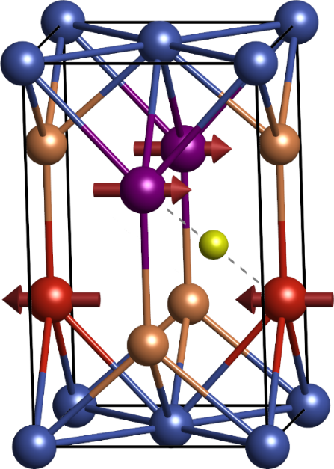
In many antiferromagnets other symmetries exist that prevent the AHE
is a symmetry
symmetry

Slide 37
Conductivity is invariant under translation and inversion
$PT$ and $Tτ$ prohibit AHE
AHE is described by anti-symmetric tensor
Can be written as a vector:
h even under inversion => pseudovector (axial vector)
h odd under time-reversal
h transforms the same as M => AHE allowed if and only if net magnetic moment is allowed

Slide 38
Symmetry operations of the point group:
Rotations:
Mirrors:
Inversion:
In MnTe no symmetry operation contains time-reversal
If there is a rotation axis h must lie along the axis => if there is more than one rotation axis AHE is not allowed
Rotations and mirrors can be broken by rotating the magnetic moments (unlike $PT$ and $Tτ)$

Slide 39
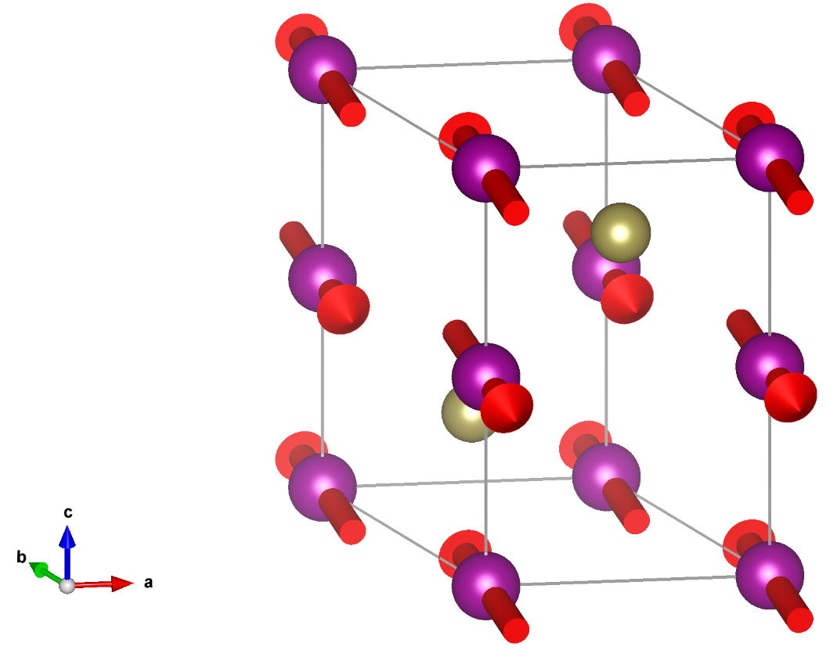
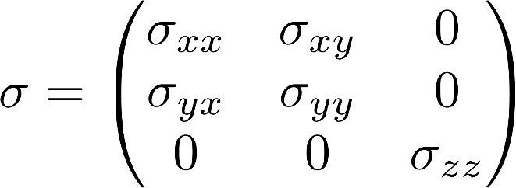
Symmetry operations of the point group:
Rotations:
Mirrors:
Inversion:
Only one rotation axis: AHE can be present
Magnetic moments along the y direction

Slide 40
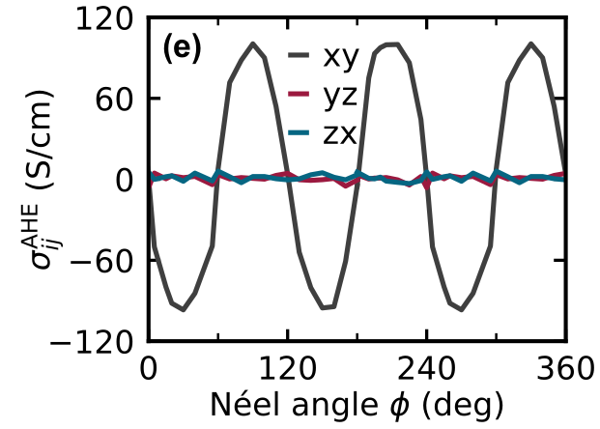
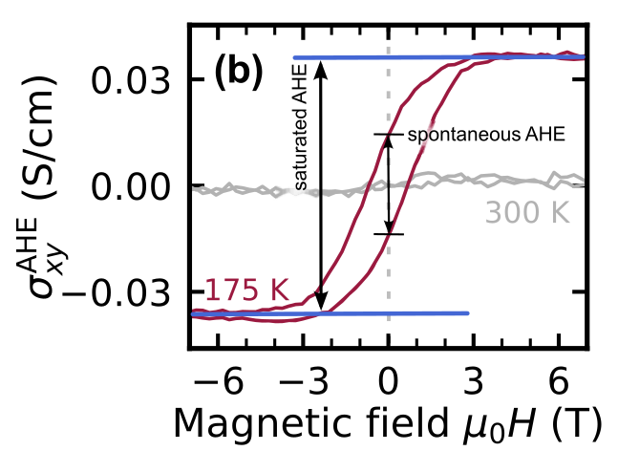
MnTe AHE calculation
MnTe AHE experiment
R. D. Gonzalez Betancourt et al., PRL 130, 036702 (2023)

Slide 41
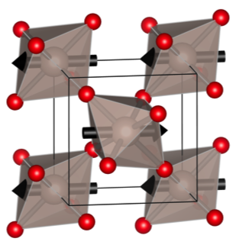
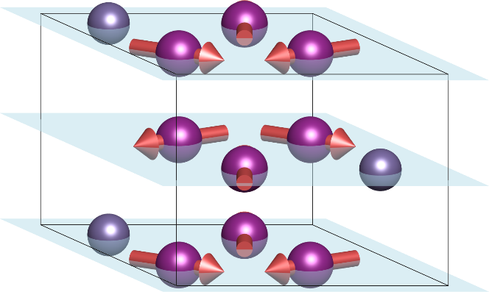
AHE has been demonstrated in many antiferromagnets:
L. Šmejkal et al., Nat. Rev. Mater. 7, 482 (2022)
Mn₃Sn
RuO₂

Slide 42
AHE allowed only if a net moment is allowed
The small net moment is not necessarily related to the AHE => two unrelated quantities that have the same symmetry
In ferromagnets: $M→0⇒AHE→0$
AHE is often assumed to be proportional to $M$
In antiferromagnets, the symmetry breaking remains even if the net moment is zero

Slide 43
M.S. Dresselhaus, G. Dresselhaus, A. Jorio, Group Theory
Crystallographic tables and tools:
Magnetic Group Tables, D. B. Litvin http://dx.doi.org/10.1107/9780955360220001
Bilbao crystallographic server https://www.cryst.ehu.es/
ISOTROPY Software Suite https://stokes.byu.edu/iso/isotropy.php
Finding symmetry group of a given material:
Findsym: https://stokes.byu.edu/iso/findsym.php
MAGNDATA: database of magnetic structures http://webbdcrista1.ehu.es/magndata/
Tensor symmetry:
MTENSOR: https://www.cryst.ehu.es/cgi-bin/cryst/programs/mtensor.pl
Symmetr: https://bitbucket.org/zeleznyj/linear-response-symmetry/

Slide 44
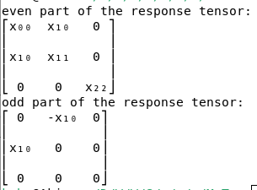
Symmetr
https://bitbucket.org/zeleznyj/linear-response-symmetry/
Python code that can directly do most of what is discussed in these lectures
Uses findsym to determine a list of symmetries for a given material
Can be installed with pip: ‘pip install symmetr’
Most features only work on Linux
Input file defining the crystal and magnetic structure
MnTe
0.00001
1
1.0 0.0 0.0
-0.5 0.866025403784439 0.0
0.0 0.0 2.0
2
P
4
Mn Mn Te Te
magnetic
0 0 0 1 3 0
0 0 0.5 -1 -3 0
0.333333 0.666667 0.75 0 0 0
0.666667 0.333333 0.25 0 0 0
Conductivity

Slide 45
Summary
Crystallographic symmetry groups
Crystallographic symmetries composed of rotations, translations, inversion and time-reversal
For global effects translations can be ignored => point groups
Time-reversal symmetry
Crucial for magnetic systems
Dissipative quantitites do not transform as naively expected => separation into T-even and T-odd components
Transformation of tensors
Apart from the time-reversal, the transformation of tensors can be determined from the constituent relations
Covariant and contravariant indices
Symmetrization of tensors
Symmetries constrain the tensor components by a system of linear equations
The system can be solved by Gaussian elimination, which allows eliminating some variables

